Slide 2
#CoalitionConversations
#SuicidePrevention
Welcome
Philip Watt
Interim CEO, Mental Health Reform

Slide 3
Key Priorities and Opportunities for the next
National Strategy for Suicide Prevention
Ber Grogan
Policy and Research Manager, Mental Health Reform

Slide 4
https://www.mentalhealthreform.ie/
https://www.mentalhealthreform.ie/membership/
https://www2.hse.ie/mental-health/
Text HELLO to 50808 to start a conversation
50808 is anonymous, free and here for you 24/7.
Support

Slide 5
Context for Suicide and Self-Harm Prevention in Ireland
504
9,533
persons died by suicide in 2020
persons presented to hospitals as a result of self-harm in 2021
Connecting for Life 2015-2024, Ireland’s National Suicide Prevention Strategy set out a vision of “an Ireland where fewer lives are lost through suicide and where communities and individuals are empowered to improve their mental health and wellbeing”
The strategy is now under review by the Centre for Effective Services ahead of public consultation, expected early 2025

Slide 6
Mental Health Reform Submission on the Review of Connecting for Life
Consultation Process
Final Submission
20 recommendations across
9 key priority areas:
9
member organisations working in suicide prevention
Alignment with existing Mental Health Policy
Early Intervention & Prevention
Eating Disorders
Out-of-Hours and Crisis Support
Data – True prevalence of self-harm
Children and young persons
Priority Groups
Funding and Implementation
Stigma
13
members of the public with lived experience

Slide 7
Spotlight: The need for timely and accurate data
Delayed Reporting:
Most recent suicide and self-harm data are from 2020 and 2021, respectively.
Suicide Classification:
The requirement to prove “beyond a reasonable doubt” that a death was caused by suicide is outdated and rooted in criminal law.
Prevalence:
The true rates of self-harm and suicide are likely much higher than currently reported.

Slide 8
Spotlight: The need for timely and accurate data
“beyond reasonable doubt…”
VS.
“...balance of probabilities”
Rooted in the historic criminalisation of suicide
Contributes to stigma
Contributes to undercount
Aligned with decriminalisation of suicide
Aligned with Northern Ireland and UK
More accurate surveillance and reporting
Research commissioned by MHR member organisation HUGG estimates the true rate of suicide is 20-25% higher than currently reported.

Slide 9
Spotlight: The need for timely and accurate data
National Self Harm Registry
9,533 individuals presented to EDs due to self harm a total of 12,661 times in 2021
Estimated more than 50,000 additional “hidden” self-harm episodes
Collects data on CHO, age, and gender
Additional demographics could identify key population groups (e.g., ethnicity, housing status, etc.)

Slide 10
Key Recommendations for Improved Data and Reporting
Review of current suicide reporting procedures, moving away
from the criminal standard of ‘beyond reasonable doubt’ to the
civil standard ‘balance of probabilities’
Improved demographic data collection for self-harm presentations

Slide 11
Professor Siobhan O’Neill

Slide 12
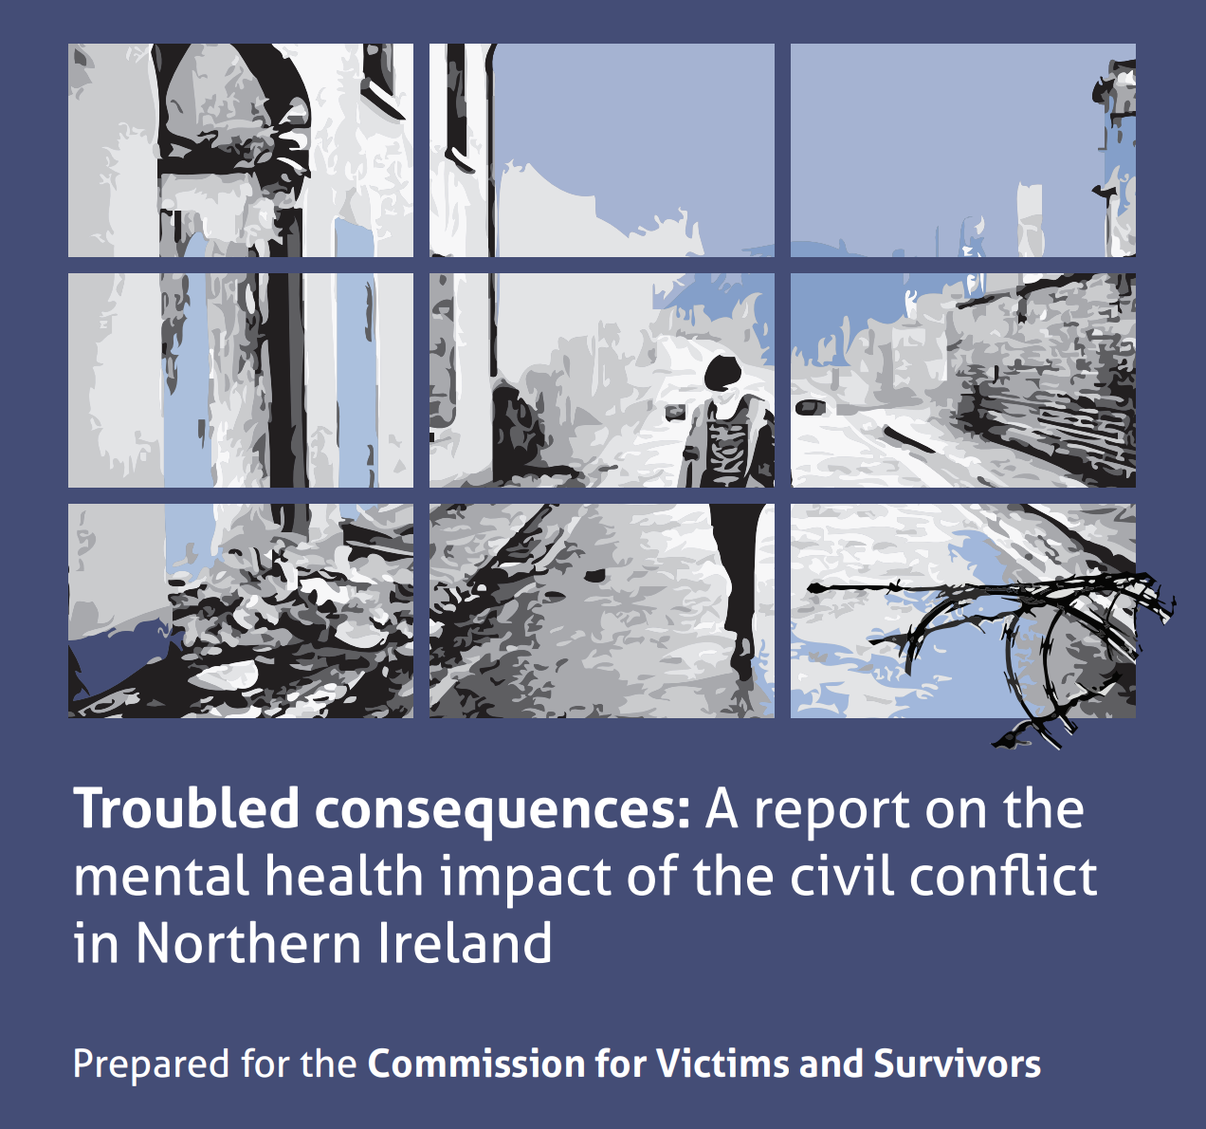
Mental Illness & Trauma in NI (2005 -2008)
39% Conflict-related trauma
18% Saw someone killed or seriously injured
39% Any mental illness
18.8% Any mood disorder
8.8% PTSD (highest)
Bunting, Murphy, O’Neill, Ferry (2011) Psychological Medicine

Slide 13
2023 data Impact of the Conflict
29.9% - conflict had an impact on their mental health (vs 21% in CVS survey).
Significantly higher % of males (35.9% vs 22.5% of females).
17.8% met the legal definition of Victim/ Survivor (vs 29.2% in CVS survey).
64.5% of those who met the definition of Victim/ Survivor, also stated their mental health was negatively impacted by the conflict.
Those who reported that their mental health was impacted by the conflict had significantly poorer wellbeing.

Slide 15
Transgenerational Trauma (Attachment)
→ self regulation, mind mindedness, mentalization.
Impacts child’s stress response & ability to self regulate.
Poor attachment linked to social difficulties, & prejudice.
Children model parental states, coping strategies, hypervigilance & violence.

Slide 16
Trans-Generational Transmission
Epigenetic risks from ongoing violence & stress
Parental limitations & mental illness compromise attachment
Child has difficulties with self-regulation
Growing child exposed to negative relationship and parenting styles
Adverse childhood increases risk of anxiety, depression and other disorders
Adolescent struggles with self regulation in times of stress, & develops mental health problems & substance use
Young adult makes maladaptive life & relationship choices
Young adult conceives children
Parental limitations & mental illness compromise attachment

Slide 17
Trans-Generational Transmission
Epigenetic risks from ongoing violence & stress
Parental limitations & mental illness compromise attachment
Child has difficulties with self-regulation
Growing child exposed to negative relationship and parenting styles
Adverse childhood increases risk of anxiety, depression and other disorders
Adolescent struggles with self regulation in times of stress, & develops mental health problems & substance use
Young adult makes maladaptive life & relationship choices
Young adult conceives children
Child has difficulties with self regulation

Slide 18
Trans-Generational Transmission
Epigenetic risks from ongoing violence & stress
Parental limitations & mental illness compromise attachment
Child has difficulties with self-regulation
Growing child exposed to negative relationship and parenting styles
Adverse childhood increases risk of anxiety, depression and other disorders
Adolescent struggles with self regulation in times of stress, & develops mental health problems & substance use
Young adult makes maladaptive life & relationship choices
Young adult conceives children
Growing child exposed to negative relationship & parenting styles

Slide 19
Trans-Generational Transmission
Epigenetic risks from ongoing violence & stress
Parental limitations & mental illness compromise attachment
Child has difficulties with self-regulation
Growing child exposed to negative relationship and parenting styles
Adverse childhood increases risk of anxiety, depression and other disorders
Adolescent struggles with self regulation in times of stress, & develops mental health problems & substance use
Young adult makes maladaptive life & relationship choices
Young adult conceives children
Adverse childhood increases risk of anxiety, depression & other disorders

Slide 20
Trans-Generational Transmission
Epigenetic risks from ongoing violence & stress
Parental limitations & mental illness compromise attachment
Child has difficulties with self-regulation
Growing child exposed to negative relationship and parenting styles
Adverse childhood increases risk of anxiety, depression and other disorders
Adolescent struggles with self regulation in times of stress, & develops mental health problems & substance use
Young adult makes maladaptive life & relationship choices
Young adult conceives children
Adolescent struggles with self regulation in times of stress & develops mental health problems & substance use

Slide 21
Trans-Generational Transmission
Epigenetic risks from ongoing violence & stress
Parental limitations & mental illness compromise attachment
Child has difficulties with self-regulation
Growing child exposed to negative relationship and parenting styles
Adverse childhood increases risk of anxiety, depression and other disorders
Adolescent struggles with self regulation in times of stress, & develops mental health problems & substance use
Young adult makes maladaptive life & relationship choices
Young adult conceives children
Young adult makes maladaptive life & relationship choices

Slide 22
Trans-Generational Transmission
Epigenetic risks from ongoing violence & stress
Parental limitations & mental illness compromise attachment
Child has difficulties with self-regulation
Growing child exposed to negative relationship and parenting styles
Adverse childhood increases risk of anxiety, depression and other disorders
Adolescent struggles with self regulation in times of stress, & develops mental health problems & substance use
Young adult makes maladaptive life & relationship choices
Young adult conceives children
Young adult conceives children

Slide 23
Trans-Generational Transmission
Epigenetic changes lead to maladaptive stress response
Epigenetic risks from ongoing violence & stress
Parental limitations & mental illness compromise attachment
Child has difficulties with self-regulation
Growing child exposed to negative relationship and parenting styles
Adverse childhood increases risk of anxiety, depression and other disorders
Adolescent struggles with self regulation in times of stress, & develops mental health problems & substance use
Young adult makes maladaptive life & relationship choices
Young adult conceives children

Slide 24
Childhood Adversities (ACEs) in NI (2019)

Slide 25
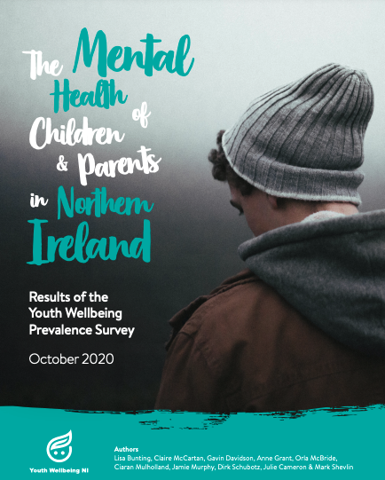
Young People’s Mental Health in NI
Any mood or anxiety disorder – 1 in 8 (12.6%).
Conduct problems – 1 in 10.
Hyperactivity – 1 in 7.
Disordered eating – 1 in 6 (16.2%).
Self-harm – 1 in 10 (9.4%).
Thought about or attempted suicide – 1 in 8 (12.1%).

Slide 26
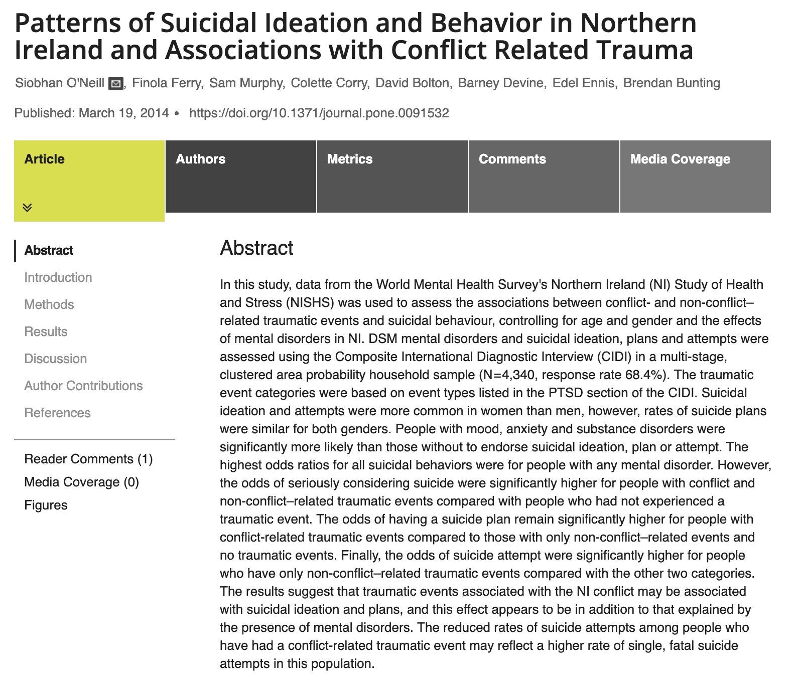

Slide 27
Suicidal behaviour in NI through a trauma-informed lens
ACEs and mental illness.
Deprivation & inequality.
Habituation to pain & violence.
Chronic stress & fear.
Hypervigilance - impulsive behaviour.
Mistrust of leaders - hopelessness.
Substance use.
Perceived injustice - reduced connectedness.
Othering - hate crime, racism, homophobia.
Normalisation & unsafe reporting of suicidal behaviour.

Slide 28
The Role of Mental Health Champion
Public Advocate.
Policy Influence.
Network Hub.

Slide 29
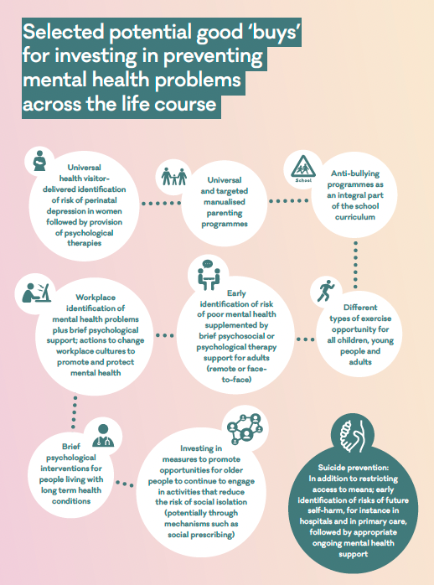
Costs at least £3.4 billion annually Where should we invest?

Slide 30
Mental Health Strategy 2021-2031
Theme 1: Promoting mental wellbeing, resilience and good mental health across society
Theme 2: Providing the right support at the right time
Theme 3: New ways of working

Slide 31
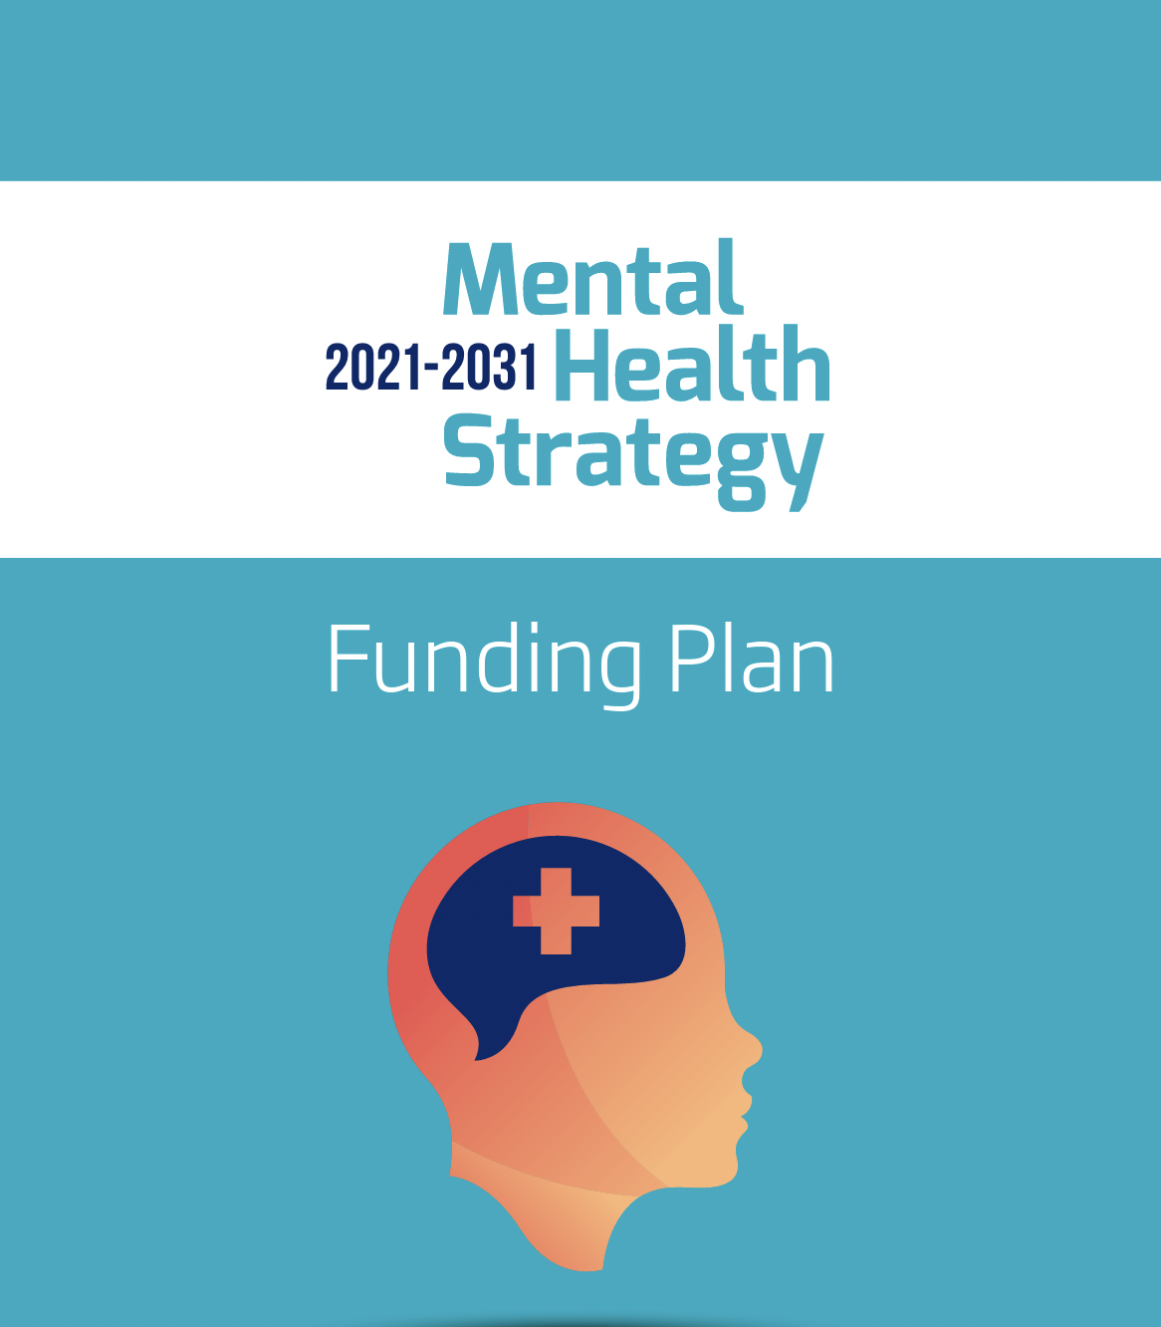
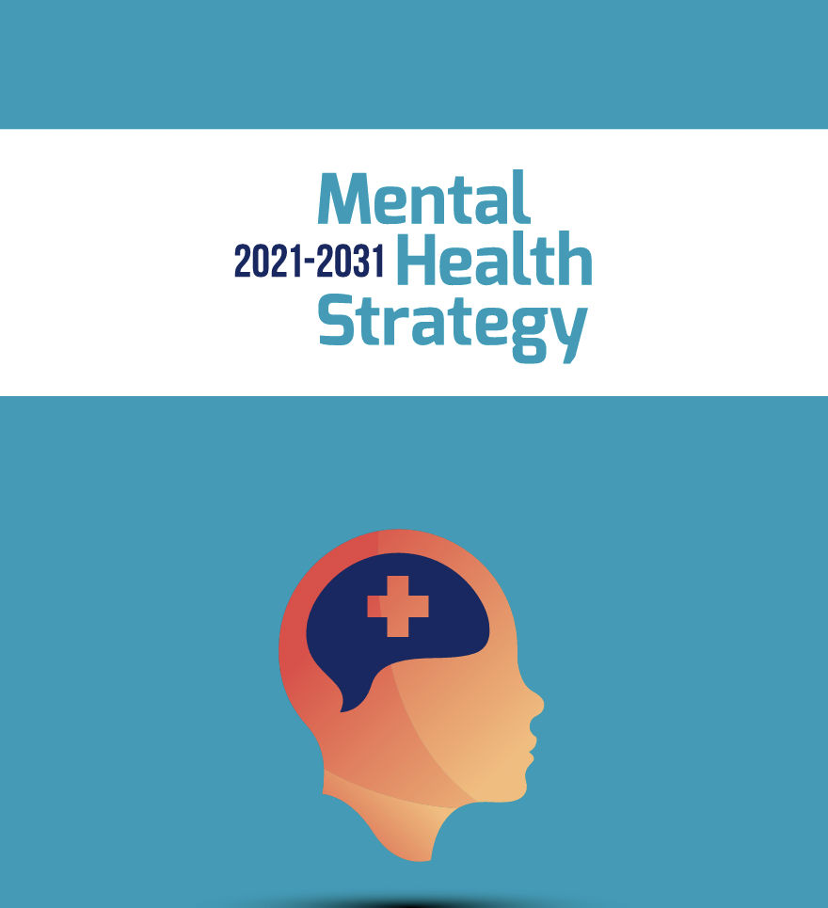
Mental Health Strategy
Funding Plan
Funding?

Slide 33
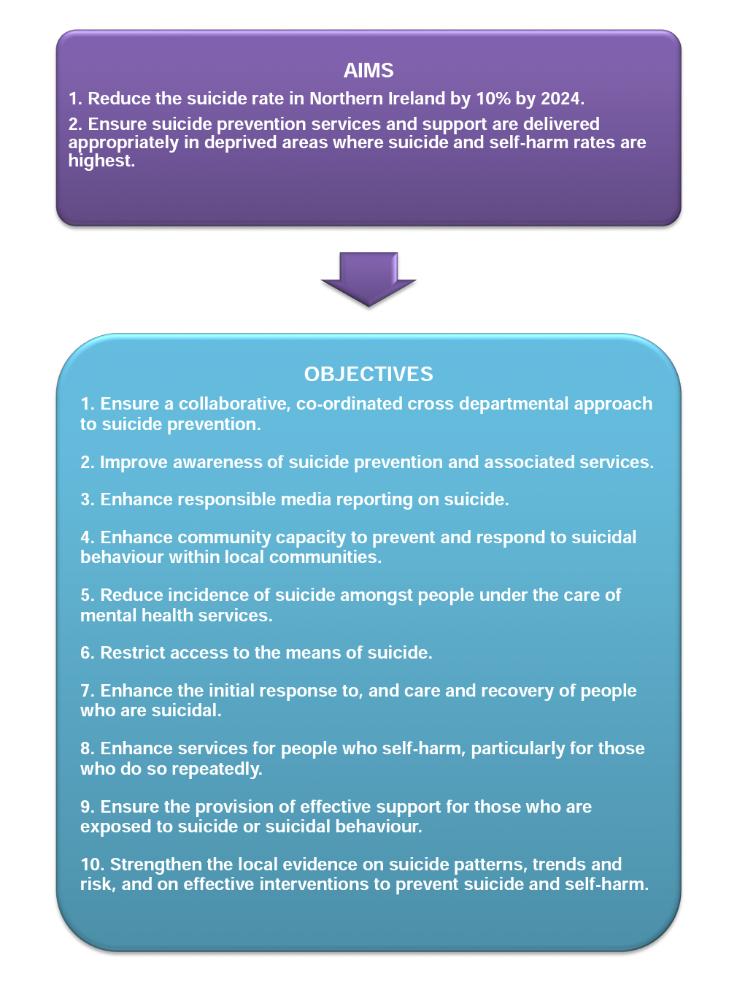

Slide 34
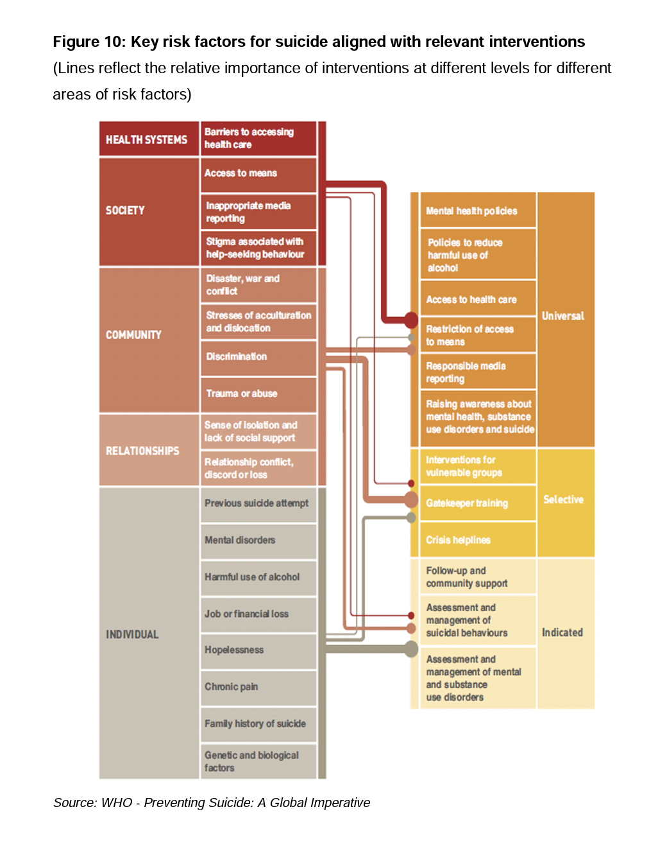
Protect Life 2 Strategy

Slide 35
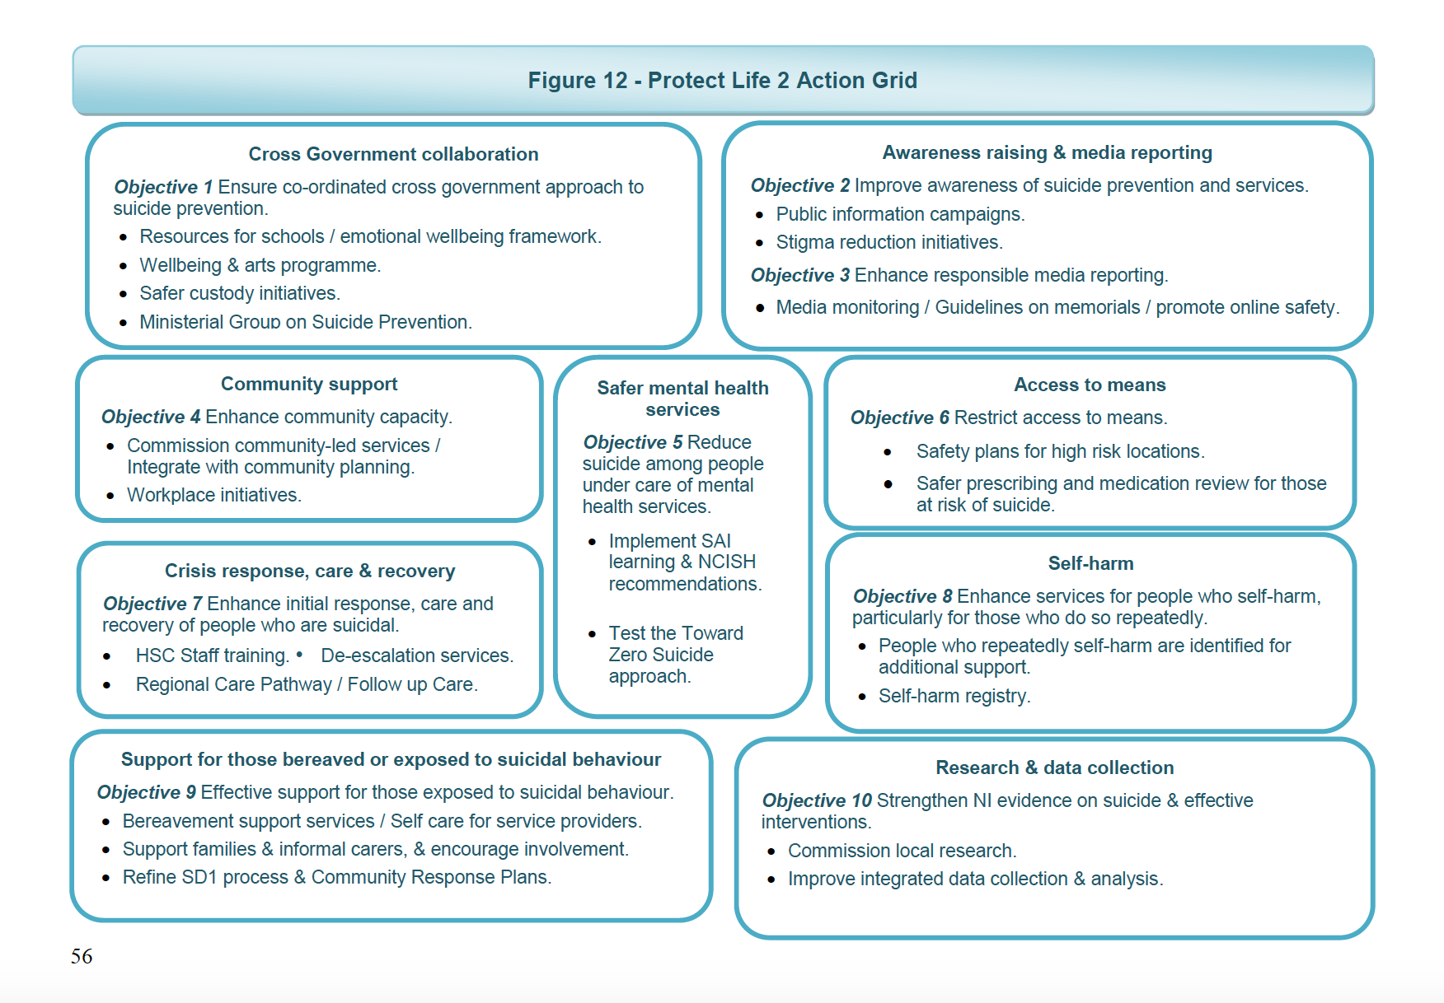

Slide 36
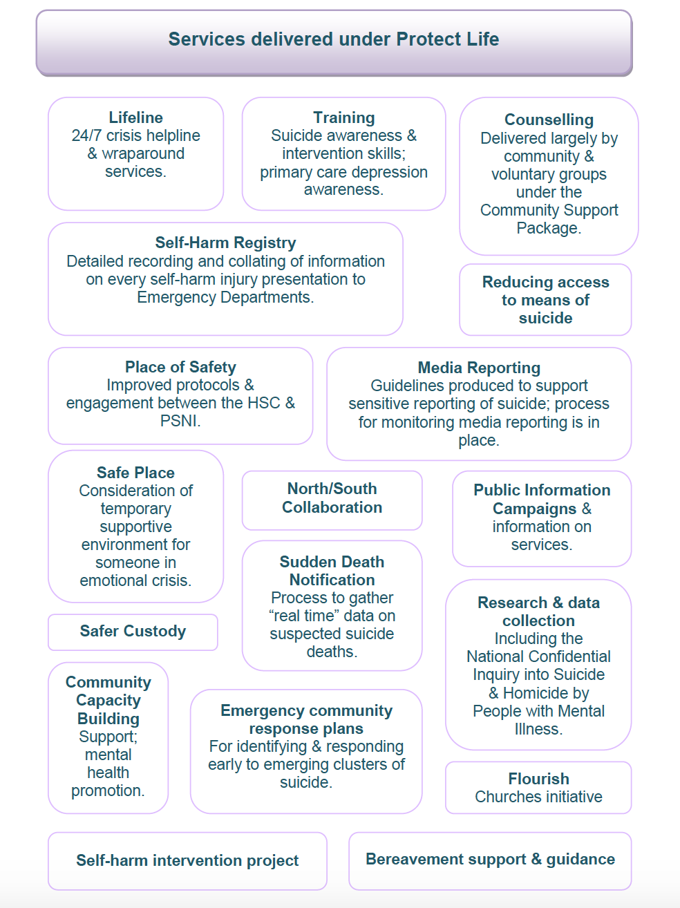

Slide 37
Towards Zero Suicide
Lead – leadership driven
Train – competent workforce
Identify – who is at risk
Engage – meaningful collaboration
Treat – treat suicidal thoughts & behaviour
Transition – attention to transition points
Improve – data driven quality improvements

Slide 38
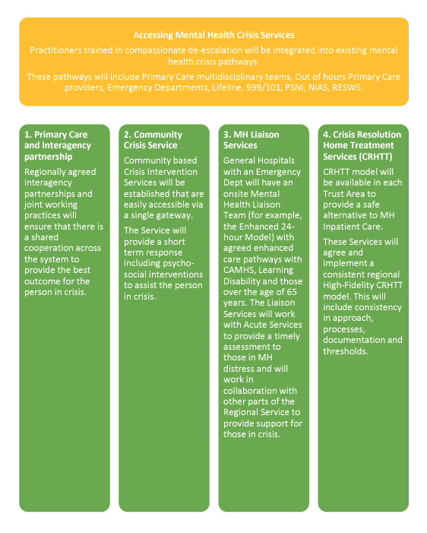
The Regional Crisis Intervention Service
A regionally consistent crisis service that will provide effective help and support for people in a crisis;
A reduction in the number of people who wait longer than 2hrs for crisis support;
A reduction in the number of people who attend EDs in crisis.

Slide 39
Pieta’s impact
Verona Farrell
National Services Manager

Slide 40
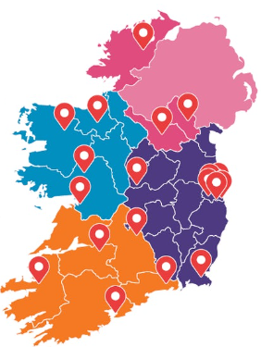
Pieta services
Prevention
Schools & Communities - Resilience Academy, Amber Flag
Awareness Raising – Darkness into Light, Know the Signs
Intervention
Counselling services: Face-to-Face / Phone / Video
12 free sessions offered to children, adolescents and adults
24-hour Crisis Text and Phoneline
Qualified therapists available 24/7 by phone and text
Postvention
Suicide Bereavement Liaison Officers (SBLO)
Proactive and practical support immediately following a suicide
Bereavement Counselling
30 free sessions offered to children, adolescents and adults
Pieta services across Ireland

Slide 41
Clinical OVerview

Slide 42
Intervention services
Counselling for suicidal ideation and self-harm
Total | 2023
Clients | 5,730
Free therapy sessions delivered | 40,974
1 assessment with 12, 1-hour sessions and wrap around supports. Free, no referral necessary.
40% of all clients are under 18, including clients under 12
60% of all clients are under 25
More than 60% of all clients identify as female

Slide 43
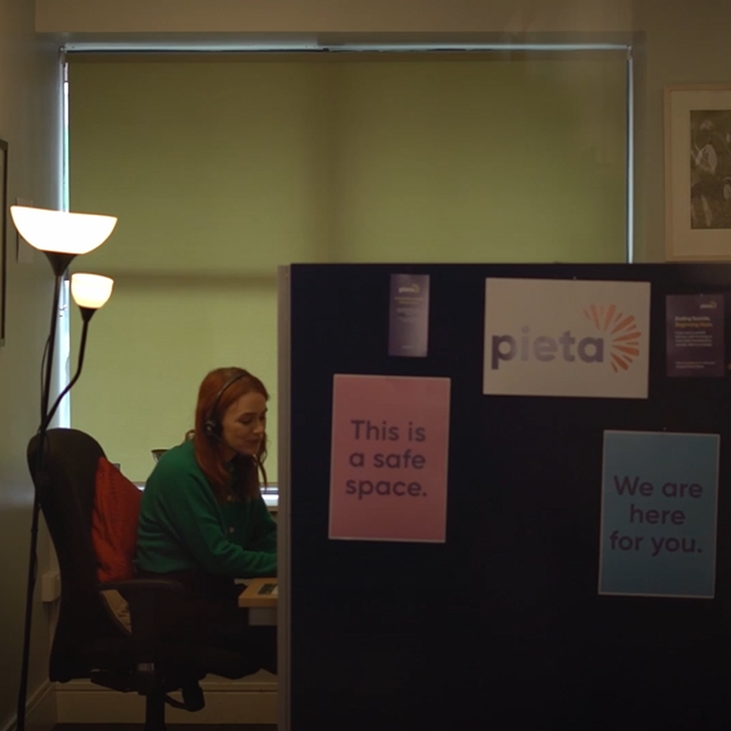
Intervention services
Crisis Text and Phoneline
Contacts | 2021 | 2022 | 2023
Calls | 41,686 | 41,622 | 40,471
Texts | 56,030 | 57,420 | 75,439
Total | 97,716 | 99,042 | 115,910
1800 247 247
Staffed by qualified counsellors and psychotherapist 24/7
What’s interesting here is the growing preference for text-based communication, particularly among younger demographics.

Slide 44
Postvention – Suicide bereavement counselling
Suicide Bereavement Counselling
Total | 2023
Clients | 889
Free therapy sessions delivered | 9,234
1 assessment with 30, 1-hour sessions and wrap around supports. Free, no referral necessary.
Number of suicide bereavement clients grew by 30% between 2021 and 2023 and continues to grow in 2024

Slide 45
Postvention – Suicide bereavement liaison Service
Suicide Bereavement Liaison Service
 | 2023
Households Supported (multiple individuals) | 606
Direct hours of support to households | 4,593
Home and community supports for families recently bereaved by suicide
Available in every county in Ireland

Slide 46
Key issues and trends

Slide 47
Who comes to our services Clinical risk level

Slide 48
Who comes to our services… Age range

Slide 49
High demand from young people
U18s Clients: All counselling 2021, 2022 & 2023

Slide 50
Who comes to our services Gender

Slide 51
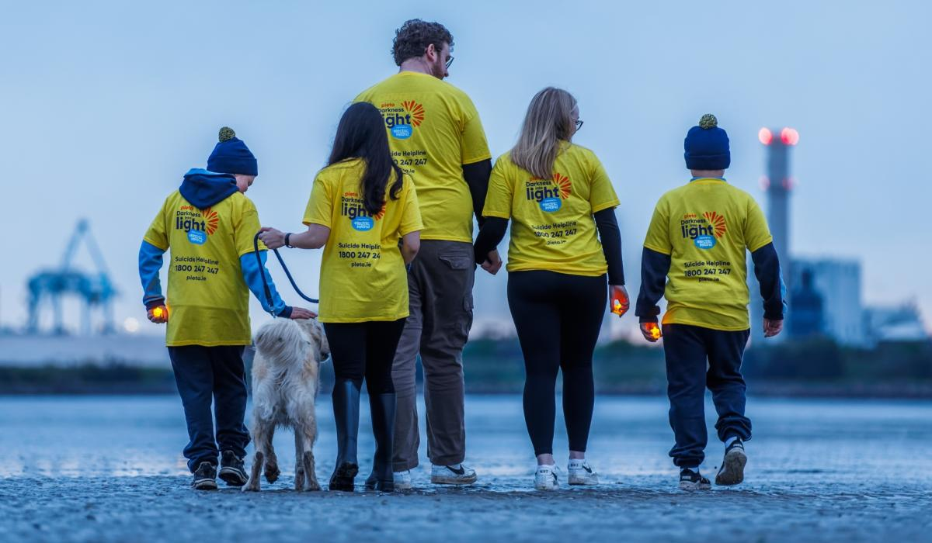
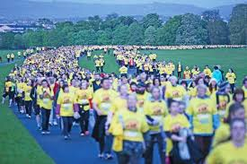
Sustainability of services
Notes:
Lack of sustainable funding delivered on a multi-annual basis makes planning and developing services extremely difficult

Slide 52
Make suicide prevention a priority

Slide 53
No more silence
Our No More Silence campaign has sought to influence the public and political narrative on suicide and self-harm
We need a transformation in how issues of suicide and self-harm in Ireland are discussed
We need a transformation in how services are coordinated to support people of all ages in crisis
We need services and supports that are sustainable, so that we can be there for people whenever they need them

Slide 54
Thank You.

Slide 55
https://www.mentalhealthreform.ie/
https://www.mentalhealthreform.ie/membership/
https://www2.hse.ie/mental-health/
Text HELLO to 50808 to start a conversation
50808 is anonymous, free and here for you 24/7.
Support

Slide 56
Bríd O’Meara
Eden Programme Manager, Suicide or Survive

Slide 57
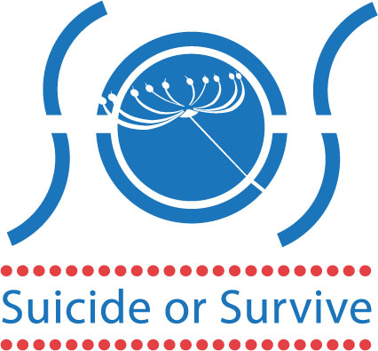
Suicide or Survive Origins
Established in 2003 - Personal experience of Founder Caroline McGuigan
Vision - A world where everyone is empowered to look after their mental health and fewer people die by suicide
Mission – to create and deliver innovative approaches that educate, inform and inspire people to cultivate good mental health and reduce stigma leading to less death by suicide.

Slide 58
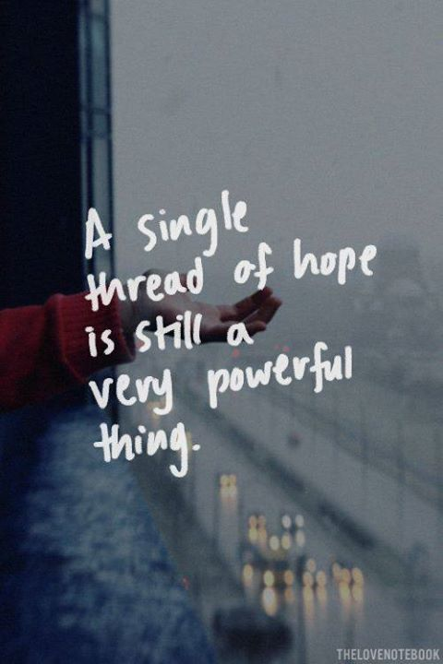
Eden Programme
Educational programme with a therapeutic element
For people over the age of 18 years who have attempted or contemplated suicide
One morning each week for 26 weeks
Closed group for up to 16 participants
Aim: to support participants to develop the skills to monitor and manage their own mental health and build a range of supports appropriate to their needs with the ultimate aim of supporting them to move away from suicide as an option of choice in times of crisis
Self-referral

Slide 59
Eden Programme
First run in 2005 – 40th programme currently in progress face to face; 41st programme currently in progress online
Online format delivered annually since 2022
The only programme of its kind internationally

Slide 60
Programme Elements
Day starts with check in – how participants are in coming to the programme and anything they put into practice since the last day
Support Document
Coffee Break
Educational Session
Check out – how are you at the end of the session and is there anything you can take away and use
Support Calls between sessions if required/ can request a support meeting with facilitators before next session

Slide 61
Evaluation Findings Programme is effective – approach of facilitators is key to this Change for participants is supported and promoted by clear structures, programme content and ethos Essence of programme is held because of support structures and governance around the programme and ongoing support for facilitators Consistent with CFL, Framework for Recovery, Government Policy

Slide 62
Benefits to Participants Benefits to daily living Increased sense of hope Belief in self and future Change in relationship with suicide Increased motivation for change Highlighted positive impact of facilitators, guest speakers and peer support

Slide 63
CORE-OM Scores Dublin 2022/2023 (7) Dublin 2023/2024 (9)
Wellbeing scores improved 29.26%
Problems scores improved 27.15%
Functioning scores improved 27.15%
Risk scores improved 50%
Suicide /Self harm related risk scores improved 48.57%
Wellbeing scores improved (9)21.3% (7)31.7%
Problems scores improved (9)18% (7)33%
Functioning scores improved (9)20.3% (7)29.4%
Risk scores improved (9)19.2% (7)47.8%
Suicide /Self harm related risk scores improved (9)19.2% (7)47.8%

Slide 64
CORE-OM Scores Kildare 2023/2024 Dublin 2024
Wellbeing scores improved 63.26%
Problems scores improved 55.46%
Functioning scores improved 58.33%
Risk scores improved 82.35%
Suicide /Self harm related risk scores improved 88.23%
Face to Face in progress: Week 20
Online programme in progress: Week 3
2025:
In person to commence in Late January/ Early February.

Slide 65
Philosophy & Ethos Everyone has the capacity to grow and develop in alignment with their full potential Equality Non-Judgemental Dignity and Respect Personal Responsibility

Slide 66
Structure and Governance
Eden Manager
Two facilitators (one Co-ordinates)
Facilitators produce a written debrief after each session – read by Manager and CEO
Participants provide written feedback every 4 weeks – read by Manager and CEO - report produced
External supervision – for some selection decisions pre-, mid-, and post-programme, and every 4 – 6 weeks when the programme is ongoing
Quarterly CPD provided by SOS
External evaluations periodically

Slide 67
Participants Voices I feel I have control of myself again – my mind. I feel I own my mind more than I did and through Eden I learned to accept personal responsibility, which was such a relief.
It has made a huge difference to my life. I learnt wealth of knowledge and wisdom. The positive part of my mind thinks I want to live and not die
People told their stories - that had the greatest impact. They had been through suicidal ideation and come out the other side.
I was going through a difficult patch in my life…Thankfully I was accepted and I haven’t looked back. It was the best thing ever.

Slide 68
MENTAL HEALTH AND SUICIDE PREVENTION FOR DEAF PEOPLE
Exploring Challenges and Solutions
Elaine Grehan Advocacy Manager Irish Deaf Society
Mental Health Reform’s Coalition Conversations Webinar
October 2024
Notes:
Good morning, everyone! ​
My name is Elaine Grehan and I am Advocacy Manager at the Irish Deaf Society. ​
​ Today, I want to discuss the important issue of mental health within the Deaf community. Unfortunately, we don’t have reliable statistics on Deaf individuals and suicide rates. However, we know we have lost members of our community without realising they needed help. This highlights the urgent need for tailored mental health services and support for Deaf people.​
I encourage you to think about how we can work together to ensure Deaf people have access to the mental health services they need.​
The Deaf community faces unique mental health challenges influenced by various factors, including communication barriers, social isolation, stigma, trauma, and inadequate access to mental health resources.​

Slide 69
KEY MENTAL HEALTH CHALLENGES FOR DEAF PEOPLE
Language deprivation ​
Communication barriers with family, schools, and healthcare​
Social isolation in rural areas or by choice​
Historical abuse
Lack of access to mental health services ​
Exclusion from community activities
Notes:
​
90% of Deaf children are born to hearing parents, but the majority of these parents don’t sign, which impacts communication and development, leading to language deprivation. ​
80% of Deaf Adults are fully fluent in English, making ISL critical for communication and equal access. ​
Sign Language was forbidden in schools. Historically this had led to cultural and linguistic oppression, leaving Deaf people without full access to communication and education ​
You can imagine how Oralism method (forcing Deaf people to rely on speech and listening on hearing aids) added heavy pressure and causes stress, anxiety and even trauma​
Currently use of ISL in the classroom is not compulsory in schools for Deaf children. Education in a child’s first or preferred language is critical to ensure equal access and development. ​
Without it, Deaf children face challenges in communication, social integration, and academic achievement, risking language deprivation and limiting their opportunities.​
Only a small percentage of Deaf people attend college or gain employment highlighting the urgent need for better inclusion and access. Limited education on both life skills and mental health awareness, largely due to systemic neglect.​
Many Deaf children grow up in residential schools where they experience various forms of abuse from peers and staff. After leaving school, these individuals often want to move on and start new lives, but they may still encounter their abusers within the Deaf community. For hearing people, moving away means they can leave their past behind, but for Deaf individuals, it’s not as simple. They cannot easily move away to escape their past unless they find another Deaf community, which in Ireland is limited. ​
This creates a challenging situation for Deaf victims who feel trapped in their environment. They may either have to face their abusers or choose to live in isolation to avoid them. Some Deaf people living in rural areas with no Deaf services or choosing isolation to avoid trauma. ​
The publication of the Ryan’s Report, Murphy’s Report and the recent Scoping Inquiry to Sexual Abuse – these reports are critical to understanding the abuse suffered by Deaf children in residential schools, and how Deaf people were easy targets due to communication barriers. ​
Gardaí have no ISL, which shows how this makes it harder for Deaf people to access justice and support during crises​
No mental health services in Ireland for Deaf people. I want to highlight the critical issue of access to mental health services for Deaf persons. Many face significant barriers, including a lack of culturally appropriate services, absence of fluent ISL interpreters, and limited understanding of Deaf culture among mental health professionals. ​
This lack of access can contribute to increased mental health issues within the Deaf community, making it essential that we advocate for improved services and support tailored to their unique needs​
The lack of Irish Sign Language (ISL) and Deaf-specific care in regular nursing homes makes it hard for elderly Deaf people to connect with others, leading to feelings of isolation and worsening mental health. Deaf children in mainstream schools often don’t get the support they need, which can make them feel left out and hurt their mental well-being. This feeling of being excluded also happens in local communities, where Deaf people have limited opportunities to participate in sports and leisure activities that are important for their mental health. Furthermore, the closing of Deaf clubs has taken away places where Deaf people could communicate easily and find support, making their isolation even worse​
Deaf people face many challenges that can make them feel isolated, lonely, and frustrated. These feelings can affect their mental health and make it hard for them to get the care they need, which can lead to depression and hopelessness. Discrimination in schools, jobs, and social situations adds to their stress, especially for those who have faced abuse, causing long-lasting mental health problems. Also, the shortage of mental health resources means many Deaf people don’t get the support they need. Struggling with their identity in a mostly hearing world can make them feel disconnected and worthless​

Slide 70
POSITIVE STEPS FORWARD
ISL Act 2017: Legal recognition of Irish Sign Language​
Belfast Statement on Mental Health and Deafness​
ISL Charter: Ensuring accessibility for Deaf people​
IDS Position Paper on Mental Health​
UNCRPD: Global recognition of rights for Deaf and disabled people
Notes:
ISL Act: The ISL Act legally recognises Irish Sign Language, ensuring that Deaf people have better access to services and promoting the use of ISL in education and public life.​
Belfast Statement on Mental Health and Deafness: This statement sets out best practices for mental health care tailored to Deaf people helping to improve understanding and support for their unique mental health needs.​
ISL Charter: The ISL Charter provides guidelines for organisations to ensure that their services are accessible to Deaf people, promoting the use of ISL and supporting the rights of the Deaf community.​
The Irish Deaf Society (IDS) establish a Mental Health and Well-Being Working Group ​ to create guidelines for the HSE mental health services to include Deaf people's needs and​ to develop a proposal for the relevant bodies to establish a Deaf Child and Adolescent Mental Health Service (CAMHS) in Ireland, similar to the services that exist in the UK. ​
Progress with Position Paper has been a bit slow, but we hope to have it ready by the end of the year.​
UNCRPD: The UNCRPD establishes global recognition of the rights of Deaf and disabled people, advocating for equal access to essential services, promoting inclusion, and ensuring that their voices are heard in society.

Slide 71
RECOMMENDATIONS FOR SUICIDE PREVENTION
Establish specialist mental health services for Deaf people​
Provide mental health services in ISL​
Train professionals in Deaf awareness and ISL​
Create Deaf-friendly environments to reduce social isolation
Notes:
The need to have the specialist services for Deaf people who have mental health issues to improve access to culturally appropriate mental health services and achieve better outcomes for service users. ​
Also, Mental Health professionals need to be trainee in Deaf culture and fluent in ISL ​
For example, ​
It highlights the geographical nature of the service provided by the three specialist units in London, Birmingham and Greater Manchester. It was identified that:​
Deaf awareness is very important​
Good mental health services for Deaf people will cost more ​
A deaf person is more likely to get better in a signing environment. ​
In UK, they have Deaf professionals qualify in mental health, such as nurses, nursing associates, social workers, clinical psychologists, OT and ward managers.​
Deaf Gain: ​
Cultural and linguistic competency in shaping deaf MH services.​
Positive impact on service users in their recovery,​
Lesser dependency on sign languages​
Deaf leadership, ​
Establishing more deaf adult mental services, ​
Deaf CAMHS to follow,​
In US, Gallaudet University to employ Deaf in healthcare​
​

Slide 72
CREATING CHANGE TOGETHER
Improved access = better mental health outcomes​
Collaboration between government, mental health, and Deaf community​
Respect and Value through ISL​
Let’s make suicide prevention inclusive for all
Notes:
Right now, Ireland doesn't have access to mental health services for Deaf people it is important to create specific support and resources to meet their unique needs​
Research shows that from a deaf perspective, hearing people use sign language, it shows respect, value, and confidence towards Deaf people. This is especially important in places that provide services for Deaf people. ​
Using sign language in mental health care helps build trust and improve results. It also shows that having access to language is about respecting people’s rights. ​
It’s crucial to have interpreters and mental health professionals involved to make sure Deaf persons are fully understood and supported.​
In short, sign language is a vital way to communicate in mental health services, making it easier for Deaf people to engage and feel supported.​
Conclusion: ​
As we move forward, let’s remember that creating change together is essential for improving mental health services for the Deaf community. ​
By raising awareness, advocating for specific support, and ensuring access to sign language in all interactions, we can work towards a future where Deaf individuals receive the care they deserve. ​
Thank you for your attention and commitment to this important cause.

Slide 73
THANK YOU
SUPPORTING ACCESS AND EQUALITY
ADVOCACY@IRISHDEAFSOCIETY.IE

Slide 74
#CoalitionConversations
#SuicidePrevention
Panel Discussion
Prof. Siobhan O’Neill
Mental Health Champion, NI
Bríd O’Meara
Suicide or Survive
Elaine Grehan
Irish Deaf Society
Verona Farrell
Pieta

Slide 75
Event Close
Ber Grogan
Policy & Research Manager, Mental Health Reform

Slide 76
https://www.mentalhealthreform.ie/
https://www.mentalhealthreform.ie/membership/
https://www2.hse.ie/mental-health/
Text HELLO to 50808 to start a conversation
50808 is anonymous, free and here for you 24/7.
Support

Slide 77
Thank you!
www.mentalhealthreform.ie
@MHReform
/MentalHealthReform
/MentalHealthReform
@mhreform

