Slide 1
How to Influence Policy Makers
Pat Montague,
MHR Training,
October 2021.

Slide 2
Great Opportunity
Speaking to your public reps can be a great opportunity
Influence their policy, their party’s and the country’s
Motivate them to act
Creates bond between you and others
Gives you a sense of power and agency
Builds momentum

Slide 3
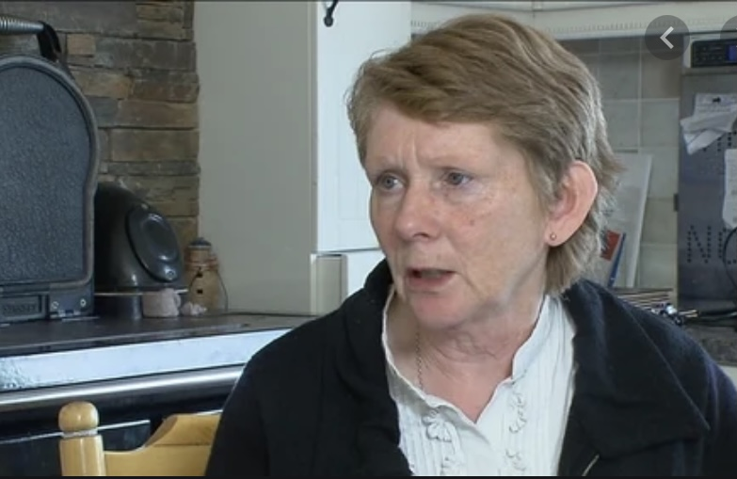
Singular Focus
People don’t remember much of what they hear – so focus & keep it simple
Concentrate on one theme – make it stick in the memory
What do you want them to take away?
Focus on what do you want people to do afterwards
Tell a great story to illustrate the theme
Spare the stats – use one killer statistic
Not for your personal vanity – why are you of interest?
Make your message stand out
Clarity, simplicity and relevance

Slide 4
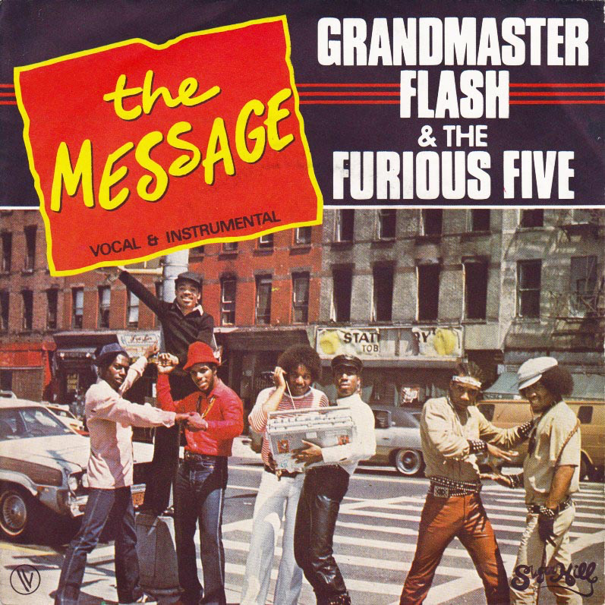
Clear Message
Be clear on core message – about action to improve MH services and vindicate rights in UNCRPD
Add supplementary information to support it
Be wary of too much detail and loads of figures
What’s the problem?
What do you want them, their party and Government to do?
What are the benefits to the wider community
Build presentation/interaction around these points
Tell them what you are going to tell them; tell them; tell them again

Slide 5
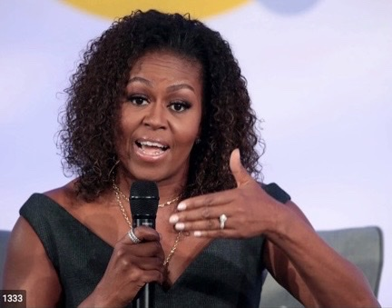
Tell a Great Story
Tell great stories to illustrate your theme
Do some research – talk to colleagues
Spare the stats – use just one killer statistic
Limit acronyms (UNCRPD for example)
This is about you and thousands of people like you
Prepare in advance
Localise and humanise!

Slide 6
Think about your Audience
Do your homework
What’s their record, what makes them tick?
Why would/should they be interested in this issue? (geography?)
Remember – they are not immersed in your work
Be prepared to explain
What’s the common ground? – build on it
Create a bridge from them to you – relate to their record, experience
Make it easy for your representative to represent you

Slide 7
Tone and Tenor
Be empathetic – we’re all on the same side
Focus on solutions – you want to make things better
However, sometimes we have to hold the line
If you’re criticising, do it with regret not relish
Be disappointed/frustrated ….. not angry
Anger generates heat not light

Slide 8
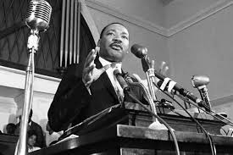
Appearance and Body Language
You never get a second chance to make a good first impression
How you look is important – do you want them talking about clothes or what you’ve said?
Smart casual or suits
Your body language is critical for connecting with your audience
Enthusiasm and passion
No folded arms or hands in pocket
Don’t use aggressive gestures – only connect with already converted and alienate rest

Slide 9
Persuade not Threaten
Ireland is a small country where everyone knows everyone else
Politics tends to work on consensual basis not ‘us and them’ – persuade across political spectrum
MHR not only one lobbying and campaigning
Multiple demands on elected reps – housing and health
Need to persuade them on your issues
Don't use threats, may work once – destroys relationships
Can lead to adverse reaction – policy makers ‘dig in’
High risk approach
If politicians deliver – even if only in part – they expect acknowledgement not a slap
You have strong case to make – do it!

Slide 10
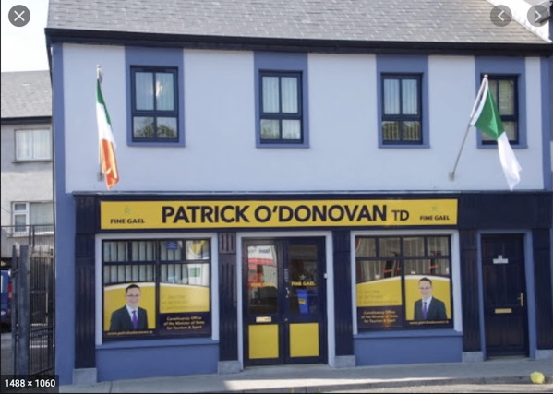
Communicating with Politicians
Meet politicians face-to-face – visit their clinics or offices (post COVID restrictions)
Next best alternative is to call them by Zoom – still got facial contact
Contact all relevant Oireachtas or Council members – give them an equal chance to support
Keep in contact with them afterwards
Provide them with updates
Seek their support
Remember to thank them for their time and attention – courtesy is a long-term investment

Slide 11
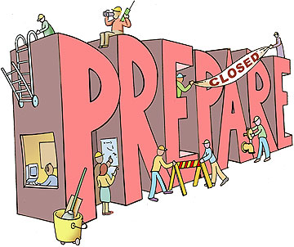
Advance Preparation
Nobody’s expecting you to be an expert on the economy
They are interested in how you are doing – you are one of their constituents
Give practical examples of the impact failure to implement UNCRPD is having on you
Tell stories – forget about stats!
Think in advance about how providing proper mental health services benefits everybody

Slide 12
Involve Wider Community
Brief family, friends and concerned community on issues
Get them to raise it on the doorsteps
Distribute information, leaflets – stalls in local towns
Ask them to lobby their politicians
Write letters to local papers
Participate in radio phone-in shows

