Slide 1

How Irish Policymaking System Works
Pat Montague,
MHR Training,
October 2021.

Slide 2

Connecting
Twitter handles
  @patmontague
  @MHReform
Email address
  pat@montaguecomms.ie
Websites
  www.montaguecomms.ie
  www.mentalhealthreform.ie

Slide 3
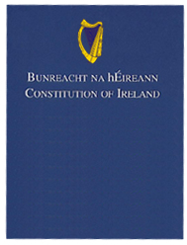
Power to the People
Irish Constitution – Bunreacht na hÉireann – adopted in 1937
Constitution gives sovereignty to people who elect Oireachtas – Dáil, Seanad and President
Oireachtas legislates – makes laws
Since Independence, Government has largely initiated laws – has been changing somewhat
Ministers largely responsible for legislating in own areas

Slide 4
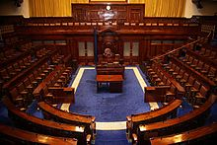
Dáil Éireann
160 TDs or deputies – they deputise on behalf of the people
Elected at general election or by-elections
At least every five years – most recent in February 2020
Represent 39 constituencies – based largely on counties
Multi-seat constituencies – three to five members

Slide 5
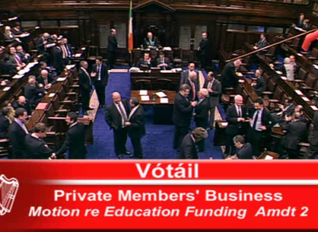
Dáil’s Functions
Elect a Ceann Comhairle, Taoiseach and Government
Pass the Budget
Enact legislation
Reality is until recently all legislation initiated by Government – Private Members Bills only proceeded if taken up by Government
Can overrule the Seanad – because elected by the people

Slide 6
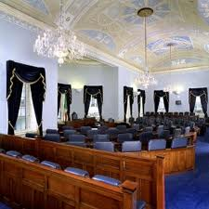
Seanad’s Functions
Elected after Dáil election
60 members – 11 appointed by Taoiseach
Others elected by Oireachtas members, councillors and some university graduates
Less powerful than Dáil – takes a second look at laws
Can be good venue to raise issues
Has limited role in financial matters – recommend not amend

Slide 7
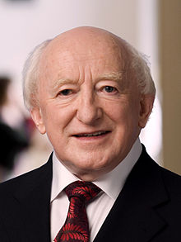
President
Largely ceremonial role
Limited powers
Unlike US or France – more like constitutional monarch
Seen as important national symbol
Role revived by Mary Robinson and her successors
Elected by people every seven years – if more than one nomination
Oireachtas and councils can nominate

Slide 8
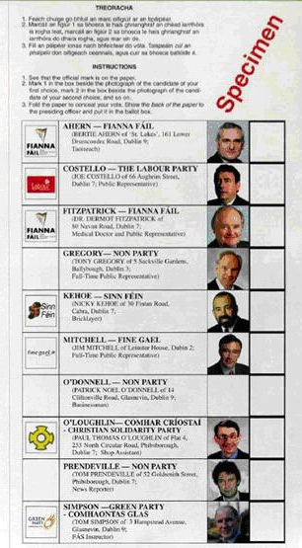
Ireland’s Electoral System
PR STV – single-transferable vote version of PR
Chosen in 19th century because of Home Rule – designed to protect Unionists
Ireland and Malta only countries with this system
Multi-seat constituencies – three to five
Ordinal ballot structure – choice over how many candidates can be supported
Electoral formula – based on quota
Proportional system – fairness
Allows for constituency representation
Electors have more choice and a greater chance of influencing outcomes

Slide 9
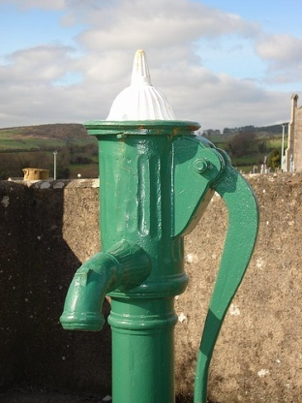
Political Consequences
Multi-seat constituencies – TDs and Councillors under pressure from own party and others
Good local service vital
Those who ignore constituencies can lose seats – including Ministers
Irish politics very localised – TDs and Councillors focus on own area and their brief
Less time for legislation and bigger picture issues

Slide 10
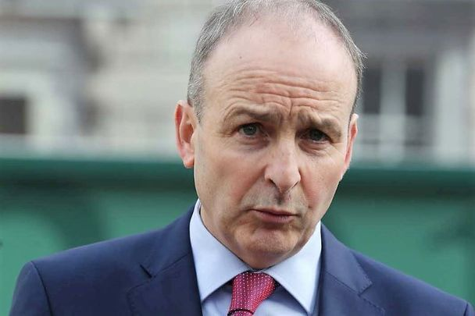
The Government
15 members of cabinet – head up 19 departments
Currently 20 Ministers of State – junior ministers
3 Super Juniors attend Cabinet but can’t vote
Cabinet usually meets once a week – 10 am on Tuesday mornings
Initiate and drive legislation – key focus for decision-making
Decisions based on memoranda
Discussions are confidential

Slide 11
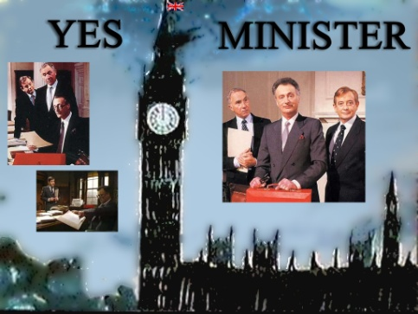
Civil Servants or Ministers
Formal political responsibility lies with Ministers
Day-to-day matters dealt with by civil/public servants – very like British system
Tasked with advising, preparing policy/legislation and implementing decisions
Act as filters on policy matters
Senior officials can also be key decision makers – more with some Ministers than others
Important role can be played by Ministers of State too

Slide 12
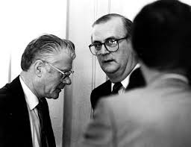
Government Very Secretive
Oireachtas open to scrutiny
Government is not
Cabinet confidentiality
Introduced Freedom of Information in 1990s
Had been reduced – last Government strengthened it again
Much policy-making done behind closed doors or in side meetings
Finance Bill – many changes seem to emerge from nowhere

Slide 13
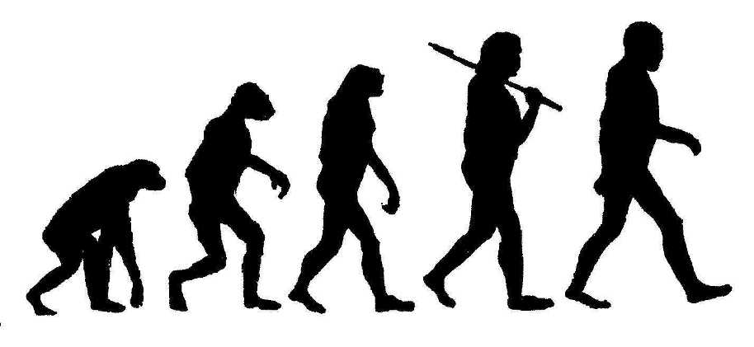
Evolving System
Significant changes in operation of Government since 1990s
Ongoing coalition governments eager to keep cohesion
Avoid rows encountered by Albert Reynolds
Memoranda circulated at draft stage
Key policy issues signed off by Leaders and relevant Ministers
Key role for Programme Managers and Advisors
Office of Tánaiste has been reinstated
Green Leader has office in Dept of Taoiseach
Act as political buffers and drivers of change

Slide 14
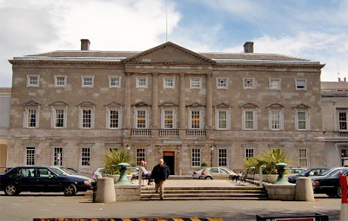
Role of Parliament
In most European countries seen to have secondary role
Changing face of Irish electoral politics since 1980s means bigger role for Parliament
Big parties dependent on independents and smaller coalition parties – input into policy
Government backbenchers can play important role in providing access and input
Delegations and parliamentary party meetings
Use of clinic cases

Slide 15
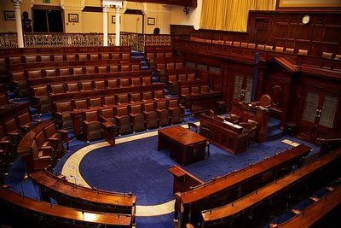
Accountability and Debate
Parliamentary Questions – hold ministers to account
Answers prepared by civil servants
Priority, oral or written
Debates on issues of current concern
Motions – express a view on a matter but not binding
Adjournment debates

Slide 16
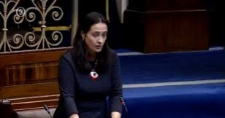
Stronger Role
Part of agreement for last Government was stronger Dáil
More consultation and discussion
Stronger powers:
  Management of own Business;
  Stronger Office of Parliamentary Legal Advisor;
  Pre and post legislative scrutiny by Committees;
  Scrutiny of Budgets – Parliamentary Budget Office;
  Resources for Committees and members;
  Changes to rules on groups.

Slide 17
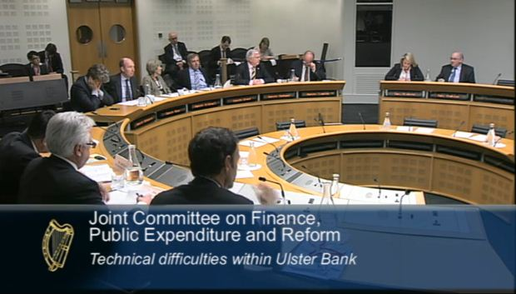
Development of Parliamentary Committees
Effective committees relatively new development
23 Oireachtas Committees – powers being enhanced and more resources
Chairs are powerful positions – consolation prizes
Scrutinise ministers (and others) and review all legislation – Committee Stage
Can hold hearings on issues – platforms to raise important points
Nature of debate less confrontational, more collegiate – Ministers open to amendments
Shortage of expert research support leaves need for outside advice and expertise

Slide 18

What is Lobbying?
Engaging with politicians and unelected officials
In the lobby of parliament or chamber
There are limits on what is up for grabs
Vast bulk of Budget based on last year’s Budget
Financial constraints – EU Budget Rules
More and more competing interests – becoming increasingly professionalised
Varying degrees of power – members, ideology, personal relations

Slide 19
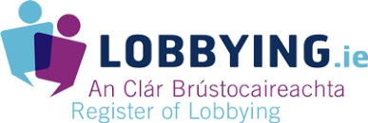
Regulation of Lobbying
Regulation of Lobbying Act came into force in 2015
Three Step Test -- www.lobbying.ie
  Are people being paid to lobby for organisation – employees or consultants
  Relevant matter – policy, law, funding
  Communicating with DPOs
If so, have to register – board decision
Make returns three times a year

Slide 20
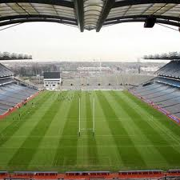
Accessible Playing Pitch
Ireland’s political system very localised – multi-seat constituencies
Most TDs and Councillors live in constituencies – hold clinics or attend meetings of local groups
What's happening in local areas is extremely important
Irish political system relatively accessible – many points of access
For example TDs often put down PQs in response to local representations
Your case needs to be communicated ‘on the ground’
Will make more impact than national representations on their own

Slide 21
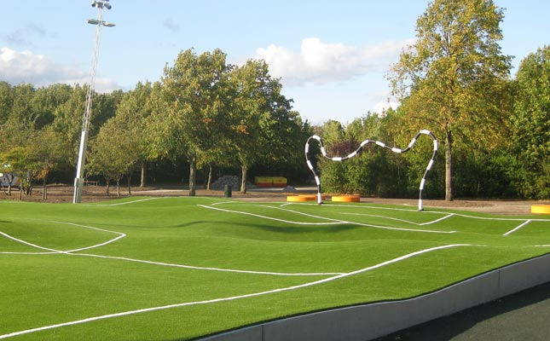
Not a Level Playing Pitch
Very competitive environment – ltd resources
Some groups have more access and influence
Many policymakers (civil servants) challenge advocacy role of NGOs – funding constraints
Key impact criterion – political power
  Social partners
  Significant commercial interests
  Supporters of political process
However policymakers well-disposed to service providing organisations with national/local reach
Very conscious of an organisation’s ‘mandate’ and extent to which they are ‘connected’
Many examples of groups with limited power punching above their weight – CF sufferers
Effective representation is the key

