Slide 1
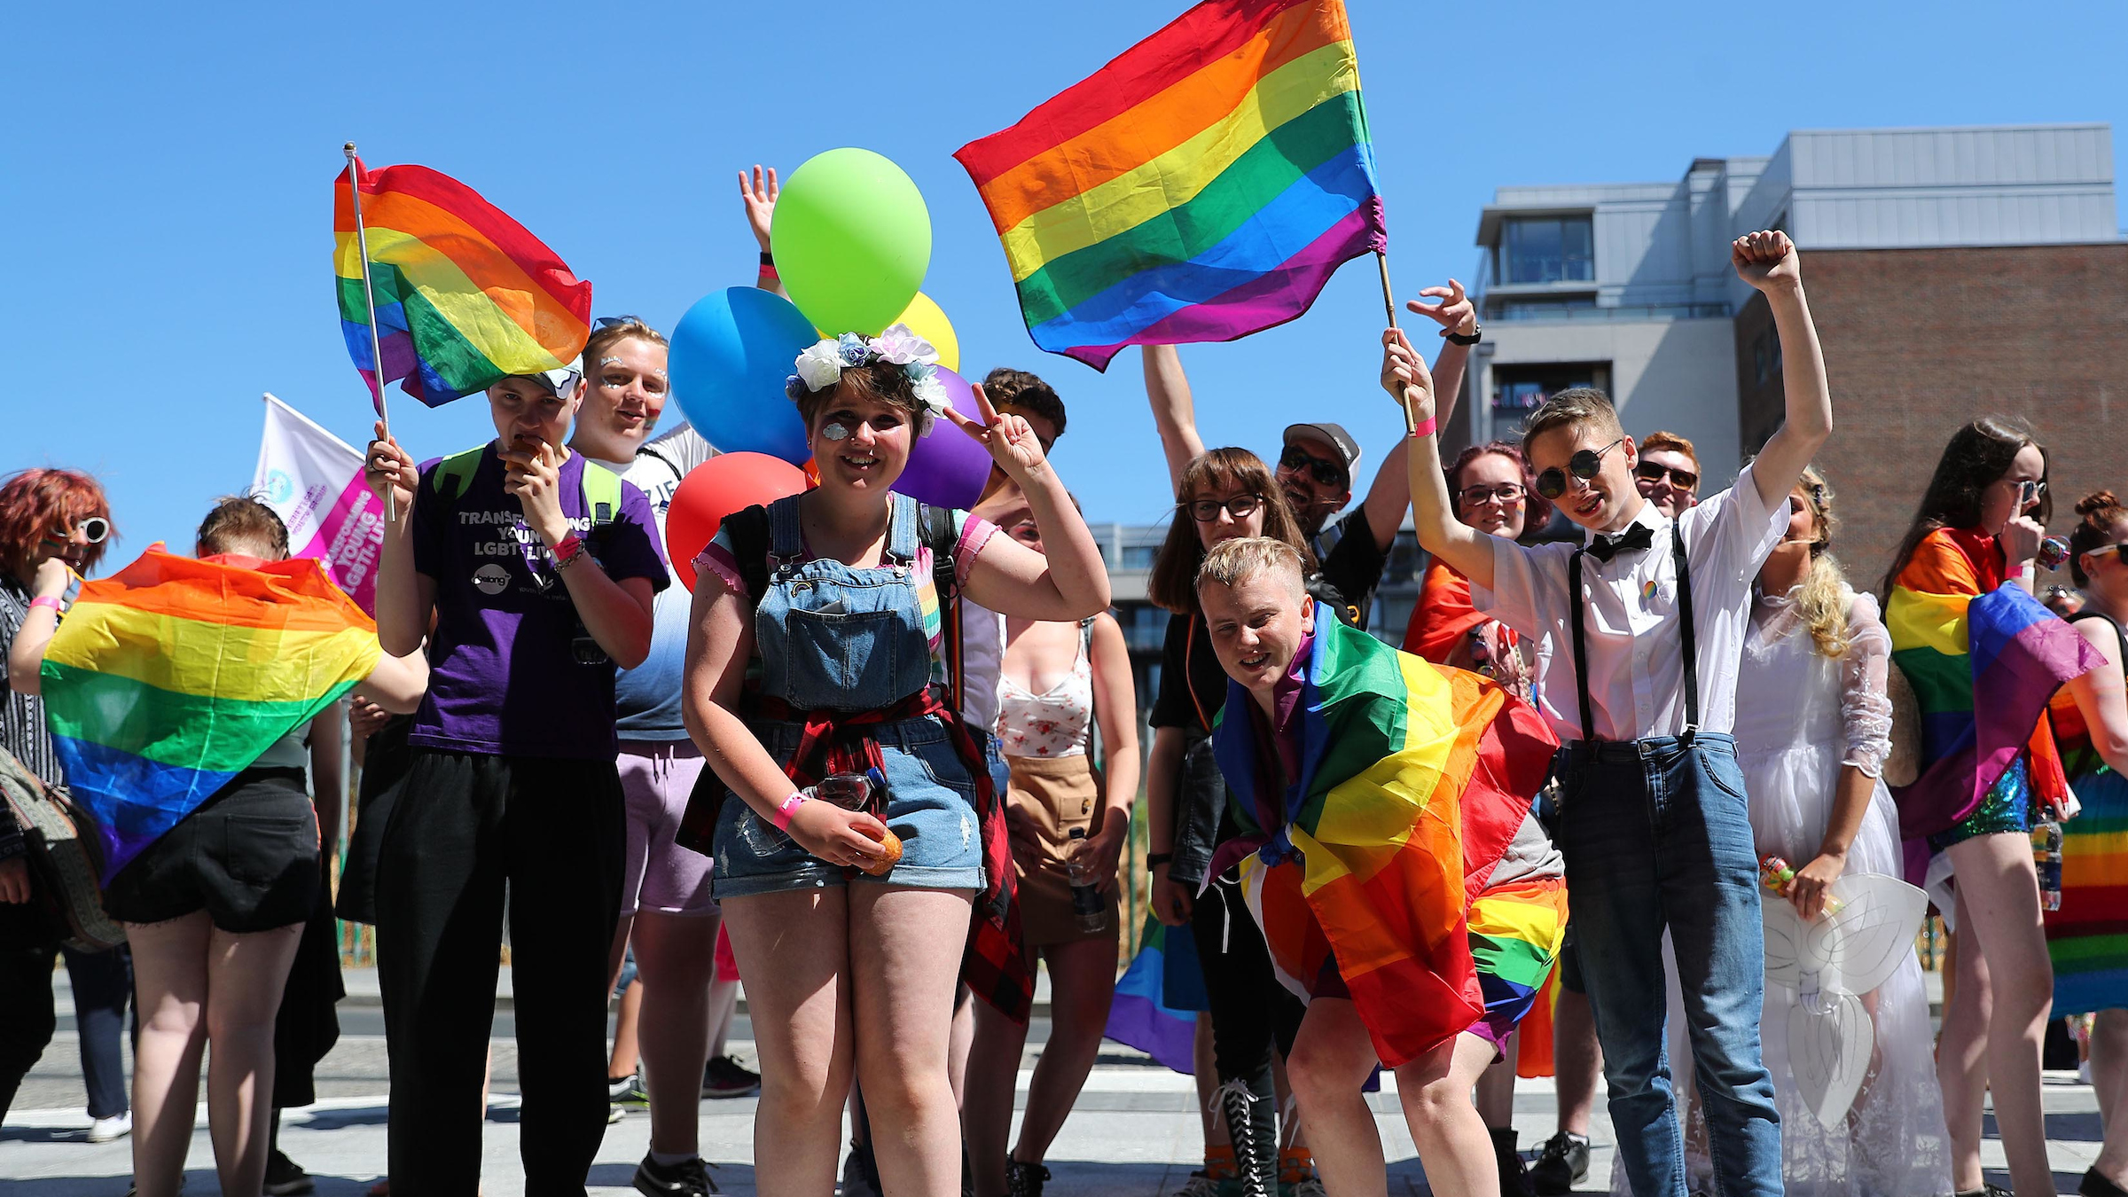

Slide 2
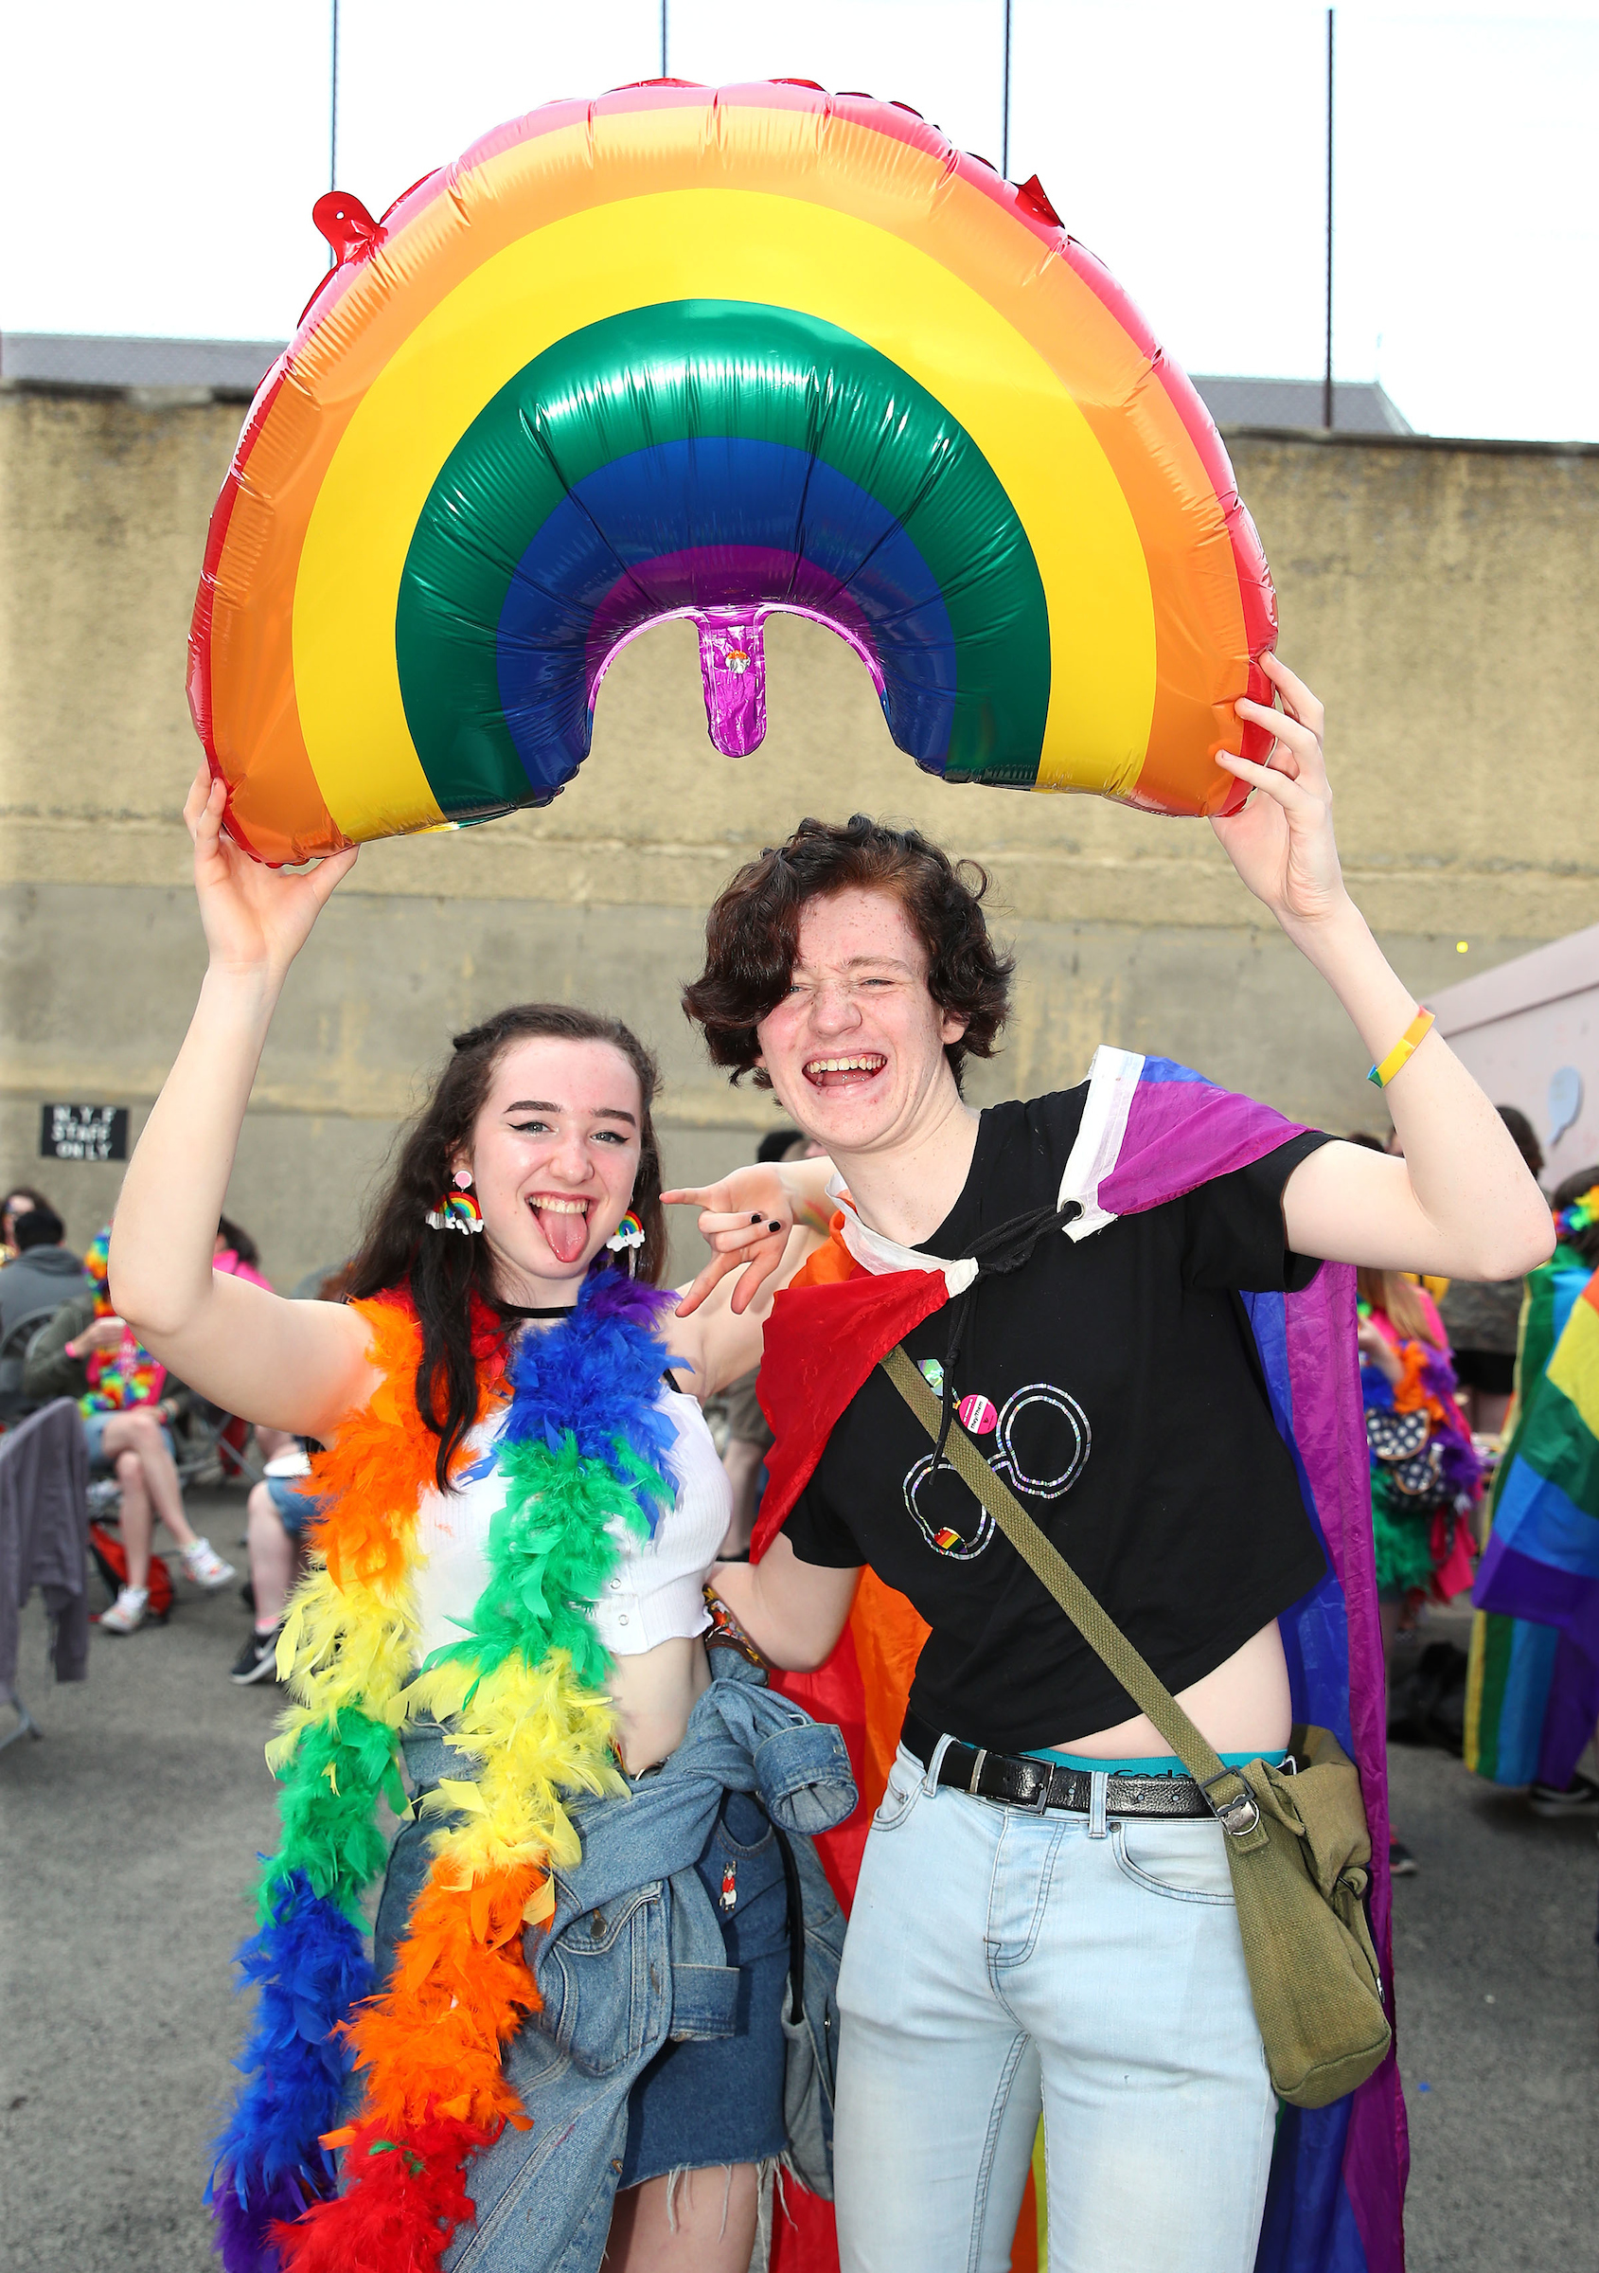
BeLonG To Youth Services is the national organisation for LGBTI+ young people in Ireland.
Since 2003, BeLonG To works with LGBTI+ young people to create a world where they are equal, safe, and valued in the diversity of their identities and experiences.
BeLonG To offers advice, information, and crisis counselling for LGBTI+ youth, also supporting free, non-judgemental LGBTI+ youth groups across Ireland.
Notes:
In order to do that, we go about our work in three distinct ways.
Firstly, youth work: we utilise a model of youth work called the Critical Social Education model. This directs us to transfer power to young people so that they may be equipped and resourced to make changes in their and their peers lives through structural change (e.g. Trans Youth Visibility Campaign, LGBTI+ Youth Strategy, etc.). We also work with other national and regional organsiations to set up and develop LGBT+ youth groups in their areas. Currently we support a total of 56 LGBT+ youth groups across the country, including 4 we run directly in Dublin.
Research plays an important role for us in that it allows BeLonG To to have the empirical evidence that shows change is needed to improve the lives of LGBT+ young people. Some of the content of today will revolve around the most recent Irish research on the lives of young LGBT+ people: LGBTIreland which was launched in 2016

Slide 3
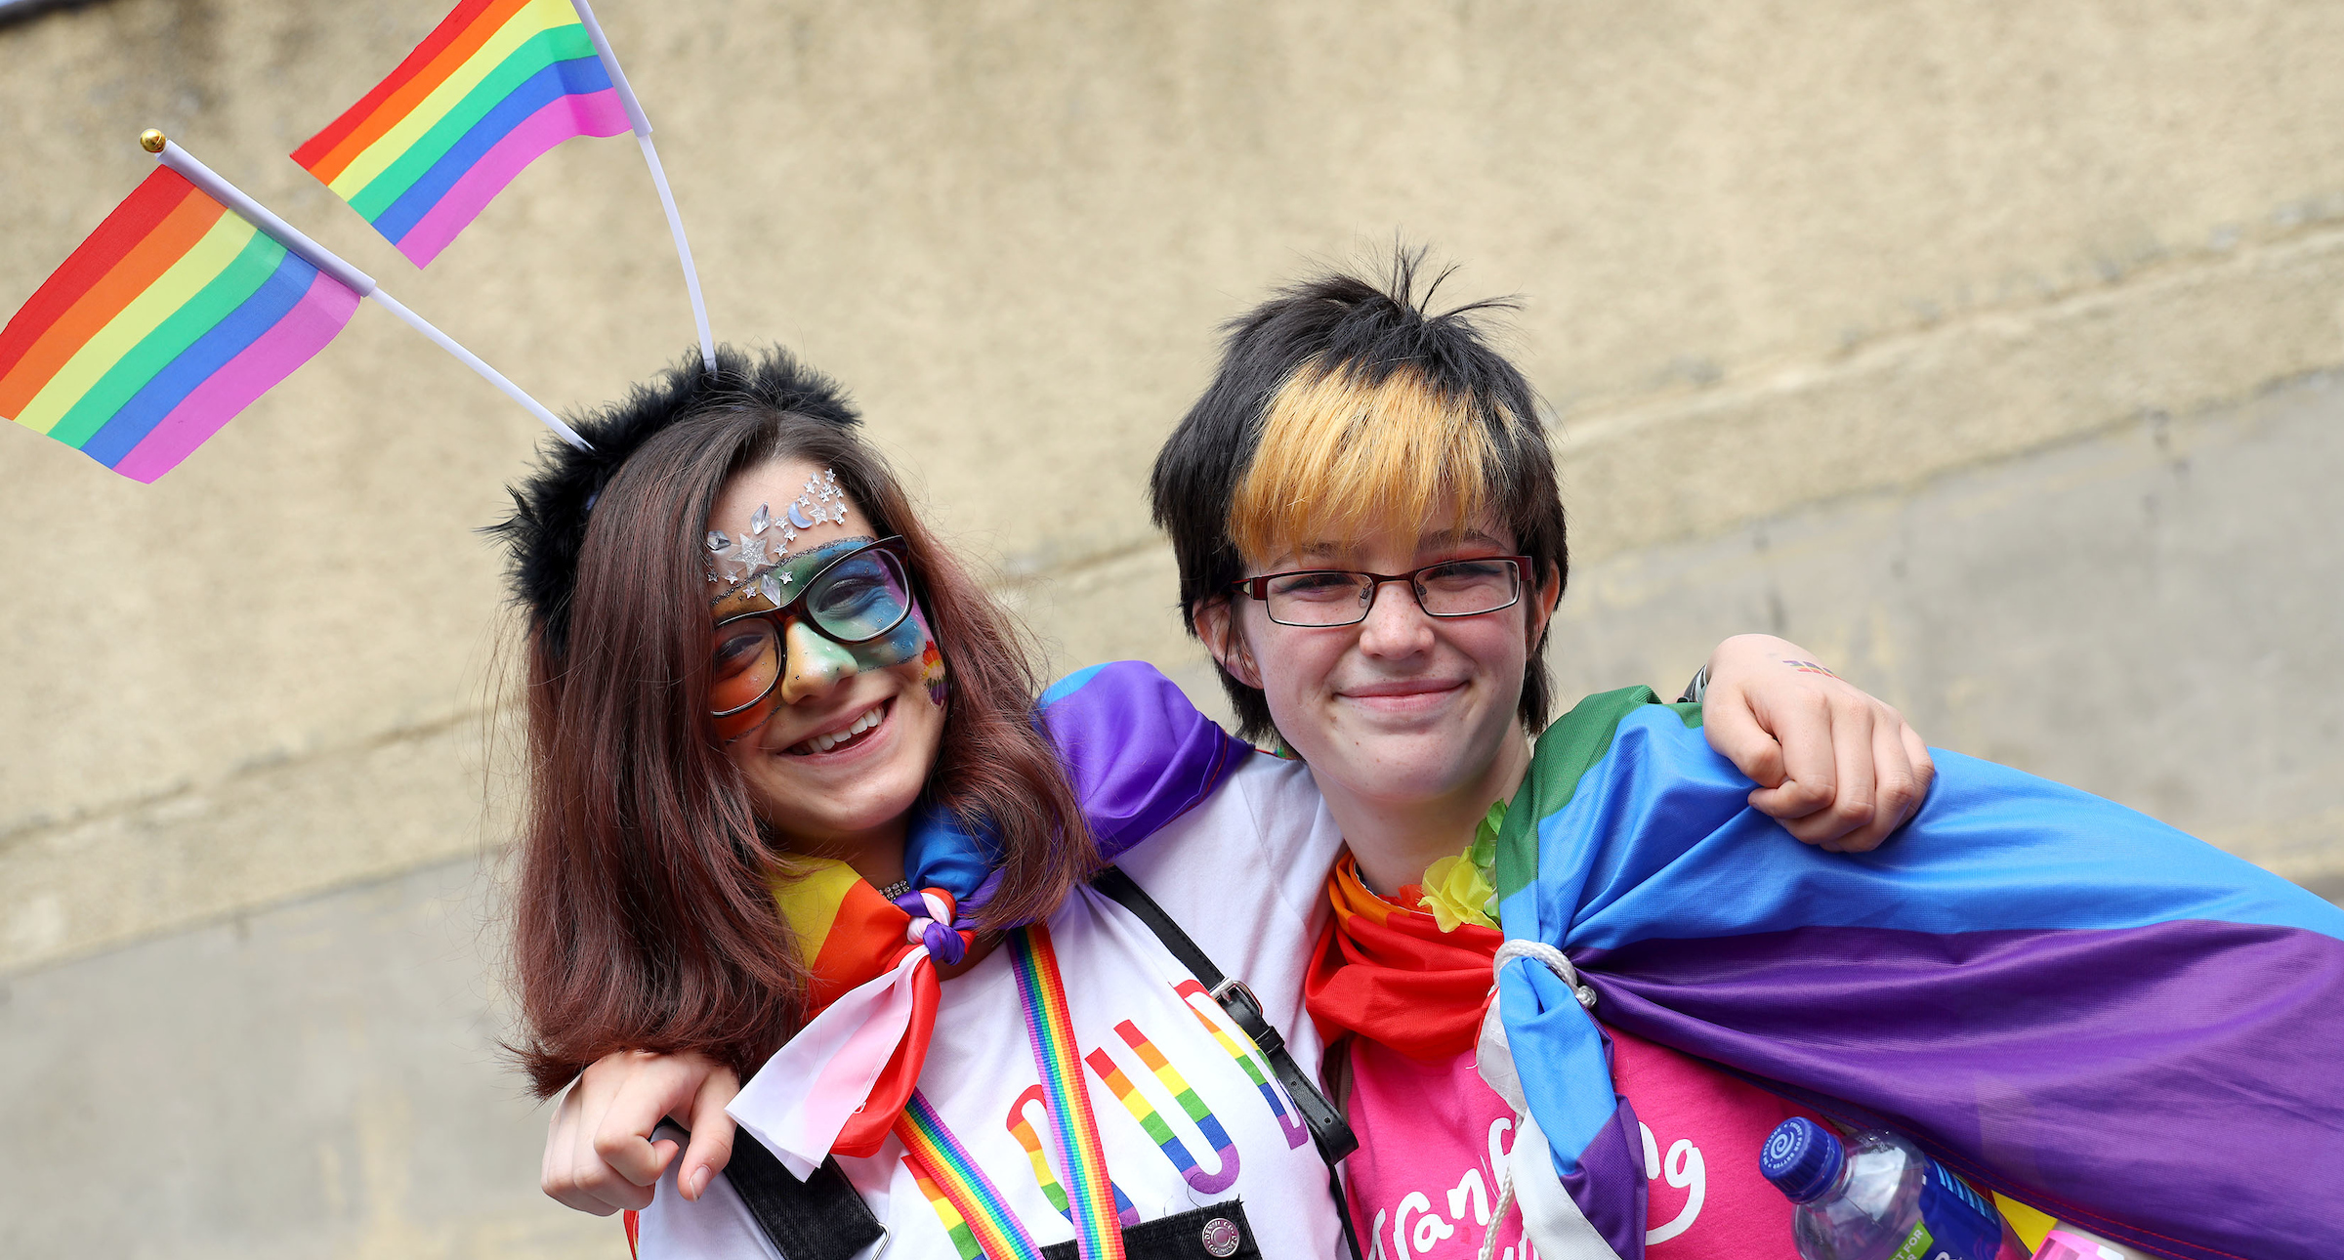
What do we know about LGBT young people and their mental health?
Notes:
Data Points / Evidence Base
LGBT Ireland Report, 2016
Better Out Than In campaign – help seeking behaviour
National LGBTI+ Youth Strategy 2018-2021 & consultation report
School Climate Report, 2019
My World 2 survey, 2019
LGBTI+ Lives in Lockdown, May 2020
How’s Your Head report
HOMES our database

Slide 4
Minority Stress
Notes:
The minority stress model, which is a conceptual framework for understanding the negative impact on health and well-being caused by a stigmatising social context (Brooks, 1981; Meyer, 1995, 2003)
While LGBT Ireland reported improvements in the lives of LGBTI people, it also highlighted that minority stress continues to have a very real negative impact on the mental health and wellbeing of LGBTI people.
Minority stress is based on the premise that LGBTI people, like members of any minority group, are subject to chronic psychological stress due to their group’s
stigmatised and marginalised status in society. While LGBTI people are not inherently any more prone to mental health problems than other groups in society, coping with the effects of minority stress can be detrimental to LGBT people’s mental health.
LGBTI people remain a particularly ‘at risk’ cohort of the population who not only experience elevated rates of mental health difficulties, but do so in part as a result of
minority stress (i.e. direct and indirect forms of LGBTI specific discrimination and victimisation, internalised LGBTI identity shame, and stress associated with LGBTI
identity concealment).
Minority stress theory in particular points to exposure to discrimination, stigma and prejudice as strong determinants informing poor mental and physical outcomes for LGBT people (Meyer 1995).

Slide 5
Evidence Base
LGBT Ireland Report, 2016
Better Out Than In campaign – help seeking behaviour
National LGBTI+ Youth Strategy 2018-2021 & consultation report
School Climate Report, 2019
My World 2, 2019
LGBTI+ Lives in Lockdown, May 2020
HOMES BeLonG To database
How’s Your Head report, 2020

Slide 6
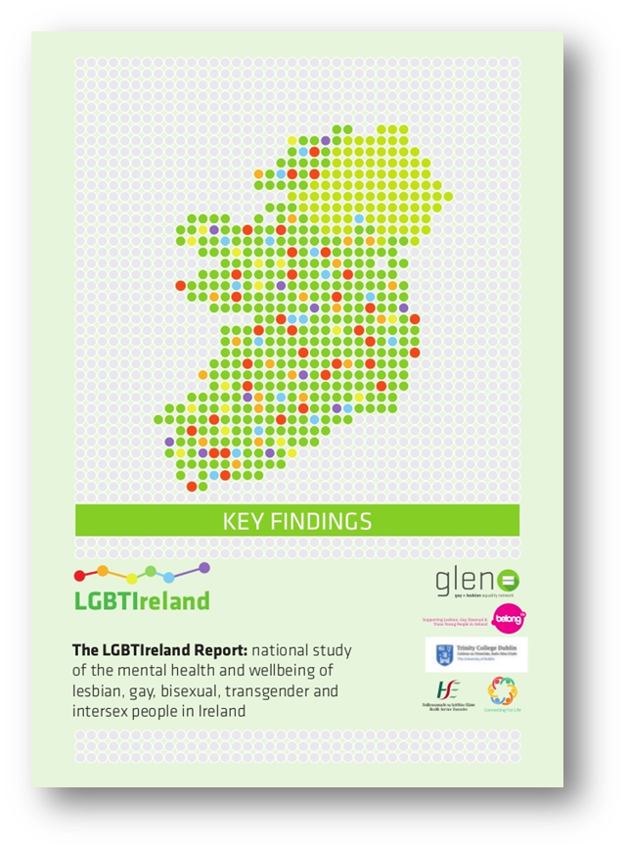
LGBT young people’s mental health
12
16
15
13
14
17
18
Experiences of homophobic and transphobic bullying, isolation, fear, embarrassment
Most common age of telling someone for the very first time
Most common age of realisation of LGBT identity
Group most likely to have:
-self-harmed
-attempted suicide
Notes:
So if we look at the timeline of an LGBTI young person, a lot of incredibly crucial events tend to happen between the ages of 12 and 18. What age do you think is the most common age of realisation of LGBTI identity? Wait for some answers.
[CLICK] 12 is the most common age for LGBTI young people to realise their identity. This figure emerged in LGBT Lives back in 2009, and remained consistent in the LGBTIreland report also. However, though 12 is the most common age for realising, young people don’t talk about their identity for a period of about 4 years. [CLICK]
16 is the most common age for telling a single person for the very first time. So this isn’t generally coming out to a community and living life openly, this is telling one single person. While these figures come form the total survey, it’s interesting to note that the stats vary widely within different age groups, e.g. those in the 12-18 age range are more likely to have shorter timespans between realisation of identity and coming out than those in the older age groups.
So the question this chart seems to conjure is what happens a) before the age of 12 and b) after the age of the 12 that indicates to a young person that the realisation of LGBTI identity is something that must be kept secret? What environment are these children and adolescents encountering that encourages them to stay silent? What support do they have? What are their life and school experiences like?
Unfortunately, the evidence points to high amounts of homophobic bullying – and we’ll be talking later on about that. There are also a lot of feelings of fear, isolation and embarrassment.
What also shows in this research is between the ages of 14-18 is a time of great vulnerability and high levels of self-harm and suicide, higher than any other age group within the study.

Slide 7
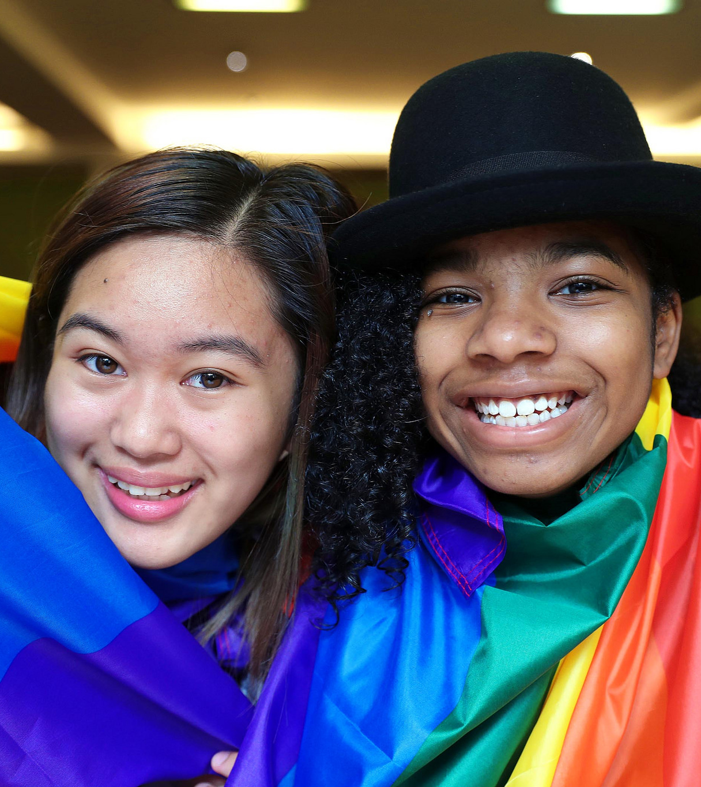
The Solution
Reduce the risk factors & increase protective factors & resilience
Notes:
Risk Factors:
Homo/bi/transphobia
Stigma / prejudice / Bias (conscious and unconscious)

Slide 8
The solutions
Policy:
LGBTI+ Youth Strategy
Implement Pathfinder
Youth Mental Health Taskforce
Access to services for under 18s
Direct Services
Build capacity with MH services with training and education
Specialist services
Early intervention & Prevention
Increase digital and face to face specialist youth services
Safe and Supportive schools & youth services
Support professionals
LGBTI+ community spaces, events
Tackle Hate crime, prejudice , conversion therapy

Slide 10
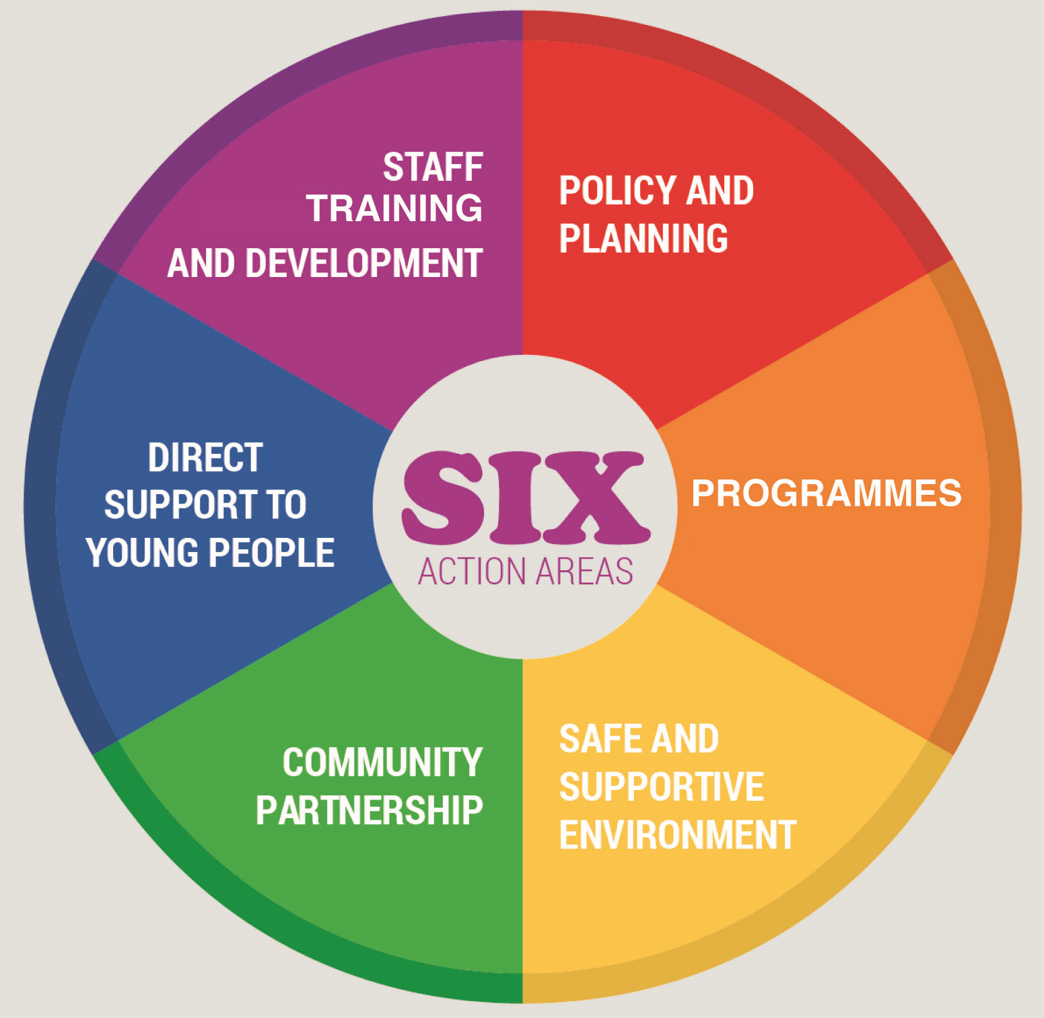
Notes:
LGBTI+ Safe and Supportive Services Toolkit- This approach, was developed by BeLonG To & the HSE, and involves a Whole-Organisation-Community model approach to change.
Exercise: We have learned a lot today about the issues that come up for LGBT+ youth. You have heard about some of the things that you can do to promote wellbeing and resilience amongst those that you interact with in your service, by being the one good adult. We have learned about stresses that may impact on all young people, and when compounded by multiple identities, that this can lead to minority stress.
Putting this knowledge together, I would like you to come up with three/four (or more if you have time) ideas or actions that you and your organisation can carry out in each of the ‘action areas’ named above.
For this, I’m going to split you into teams, each one given a specific area (or two depending on numbers).

Slide 11
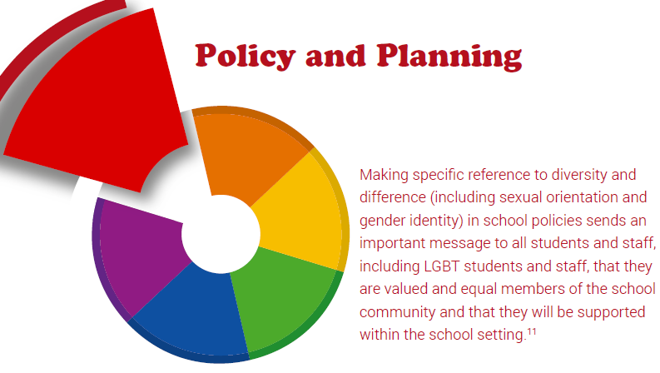
Making specific references to diversity and difference (including Sexual orientation and Gender identity) in organisational policies sends an important message to all service users and staff, that they are valued as equal.
Notes:
Policy and Planning Actions:
What Your Youth Service
Can Do
Review the Anti-Bullying Policy, ensuring that:
• Homophobia and transphobia are explicitly named as identity based bullying in the policy definition.
• All staff are aware of the policy and their role in implementation,
particularly in relation to homophobic/transphobic language and
name-calling.
• A ‘no tolerance’ approach is taken by all staff in relation to
homophobic/transphobic language and homophobic/transphobic
name-calling throughout the service and in all aspects of
organisational life.
• Young people have had an opportunity to input into the AntiBullying Policy and other relevant policies to promote ownership
and awareness.
• The policy is openly discussed and communicated with young
people, ensuring that everyone is aware of the procedures for
discussing and reporting bullying should a concern arise.
• Make explicit reference to the nine grounds of Equality
Legislation, including sexual orientation, gender identity &
expression, and sex characteristics (SOGIESC), in youth service
policies and mission statement.

Slide 12
Programmes
The absence of opportunities to discuss LGBT issues in a respectful way can perpetuate negative beliefs and attitudes; whereas raising these issues through programmes provides opportunities for workers to challenge negative beliefs and attitudes and promote respect and dignity for all.
Notes:
Programme Actions: What
Your Youth Service Can Do
• Ensure your youth service has a diversity and inclusion policy that
is put into practice when running programmes and workshops.
• When delivering sexual health workshops and programmes,
include LGBTI+ identities and specific sexual health needs.
• Ensure the themes of sexual orientation and gender identity are
an integral part of workshops and programmes delivered.
• Ensure that in your service, homophobic/transphobic bullying is
explicitly mentioned when discussing bullying.
• Ensure that in your service, the diversity of families is discussed
in your diversity and inclusion workshops, including same sex
parenting.
• Ensure that in your service, sexual orientation and gender identity
is raised and/or taught about in other programme activities.
• Ensure that in your service, respect and tolerance for diversity is
promoted in all programme activities and groups.

Slide 13
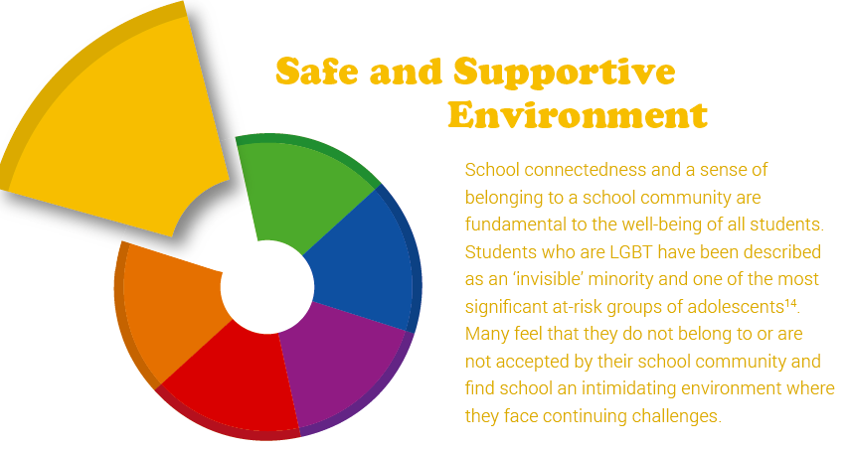
Connectedness and a sense of belonging within a service is extremely important to service users. Those that are LGBT can often feel invisible and this is particularly true to adolescents. Making an environment overtly inclusive not only encourages young people to be themselves, but also may encourages help seeking when they need it.
Notes:
Safe and Supportive
Environment Actions: What
Your Service Can Do
Promote a supportive physical and social
environment by:
• Creating a safe space where everyone is valued and treated with
respect.
• Displaying LGBTI+ affirming posters and provide information
about local and national supports for LGBTI+ young people, which
young LGBTI+ members can access confidentially outside of the
Service environment if desired.
• Encouraging whole organisation participation in the BeLonG To
annual Stand Up Awareness Week campaign.
• Encouraging all staff members, to challenge homophobic and
transphobic language in the wider youth service environment,
including group meetings, organisation events, sporting events
and field trips.
• Ensuring ongoing monitoring and supervision of toilets for the
occurrence of bullying incidents. This isolated environment, as
well as the vulnerability of LGBTI+ young people, can result in
dangerous situations.
• Remove homophobic/transphobic graffiti immediately. If
appropriate, remind perpetrators of organisational policy on
homophobic/transphobic language.

Slide 14
Proactive linking with those outside your organisational environment in relation to LBGT+ issues, including parents/ guardians and other organisations will help raise awareness that your organisation is an inclusive space which respects and embraces diversity. This can also be useful in developing possible referral pathways.
Notes:
Community Partnership
Actions: What Your Service
Can Do
• Make explicit reference to the grounds of Equality Legislation,
including sexual orientation, and gender identity, in the
organisation policies and mission statement which are made
available to local organisations.
• Develop links with local schools and share learning on how to
make environments inclusive of LGBTI+ young people.
• Use induction evenings and parent/guardian information
evenings to highlight your organisations position and work to
ensure LGBTI+ young people are fully included. Articulate that
homophobia/transphobia will not be tolerated and affirm that
the organisation supports all, including LGBTI+ young people,
families and staff.
• Display LGBTI+ inclusive posters in a visible area where visitors
to the organisation can see them.
• Provide information on LGBTI+ support groups and other
supports to families on request.

Slide 15
LGBT+ young people may disclose their sexual orientation or gender identity to any staff member. It would be best that all staff are made aware of how best to support an LGBT young person, or whom to refer them to.
Notes:
Direct Support to Young
People Actions: What Your
Service Can Do
• Ensure that youth work teams can provide additional support to LGBTI+
young people.
• Ensure that all members are aware of key staff members whom they can
approach for support.
• Highlight to all staff that they may be the person to whom a LGBTI+ young
person discloses their identity and ensure that they can respond sensitively
and appropriately. This includes:
:: Acknowledging that the disclosure of LGBTI+ identity takes significant
courage on the part of the young person.
:: Giving the young person adequate time to talk, including setting aside
a specific time/appointment if it is more convenient. This appointment
should be the same day if possible.
:: Being guided by the young person as to their support needs.
:: Signposting the young person to additional supports (internal and
external) if requested.
:: Recognising that the LGBTI+ young person’s right to privacy and
confidentiality should be the same as that of non-LGBTI+ young people
(in keeping with Child Protection Guidelines).
:: Consider that trans young people may have particular needs around
bathroom spaces, preferred names and pronouns.

Slide 16
Fundamental to any organisations response to supporting LGBT+ issues, is the willingness of staff and management to be open to creating an environment that acknowledges and supports these identities. Training gives staff the chance to explore and expand their knowledge, as well as confidence in working with LGBT+ young people.
Notes:
Staff Training and Development
Actions: What Your Service Can Do • Source whole-team LGBTI+ awareness training. BeLonG To provides online LGBTI+ training. Find out
more at www.belongto.org or by calling 01 670 6223.
• Source specific LGBTI+ awareness training and development opportunities for staff, particularly
senior staff and staff with a role in providing direct support to young people.
• Ensure that trained members of staff disseminate the main points and recommendations from
training if not all staff can attend.
• Training should be practical in nature and include role-play e.g. responding to incidents of
homophobic/transphobic name-calling; responding to a young person ‘coming out’.Skills/training audit?

Slide 17
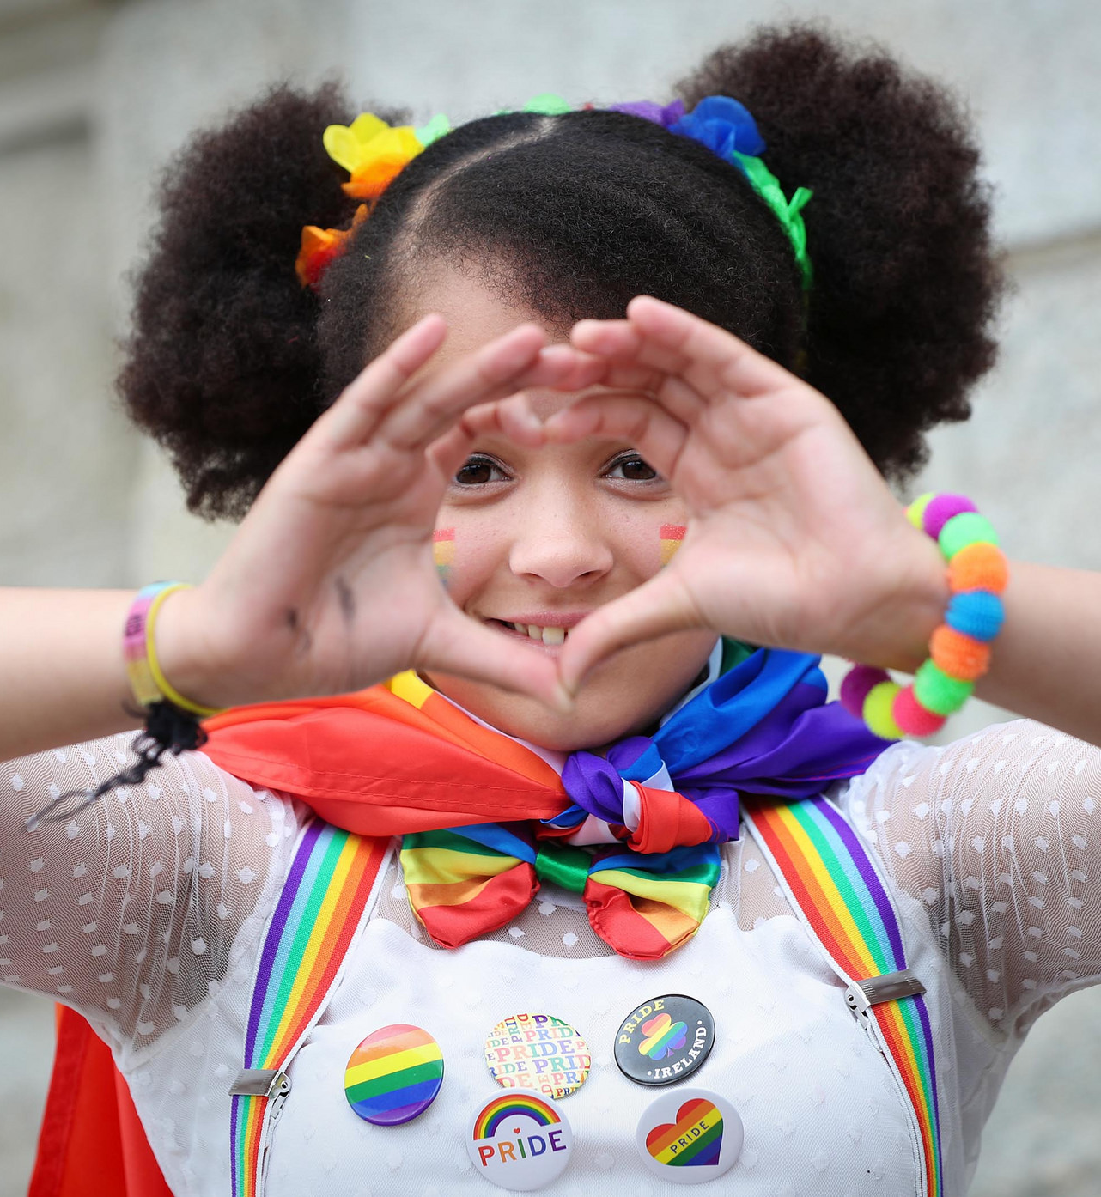
www.belongto.org
@BeLonG_To
facebook.com/belongtoyouthservices
youtube.com/belongto

